Slide 1
Gendered Patterns of Parliamentary Attention
Using computer vision to uncover behavioural biases among elected politicians
Oliver Rittmann, University of Mannheim
Research Talk, London School of Economics and Political Science
January 27, 2026

Slide 2
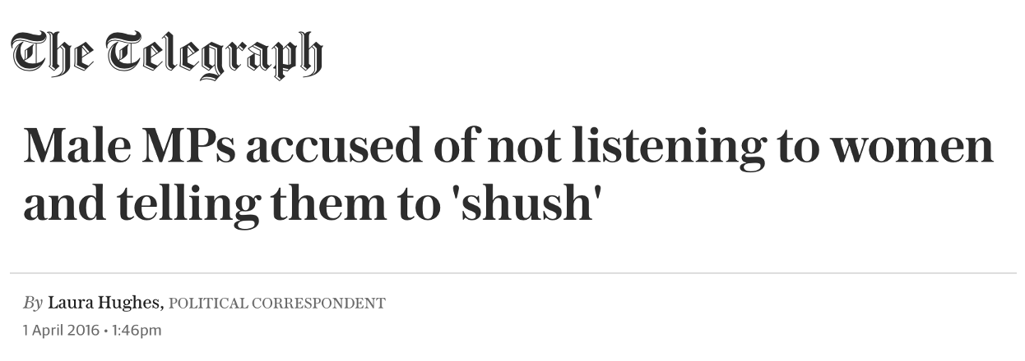
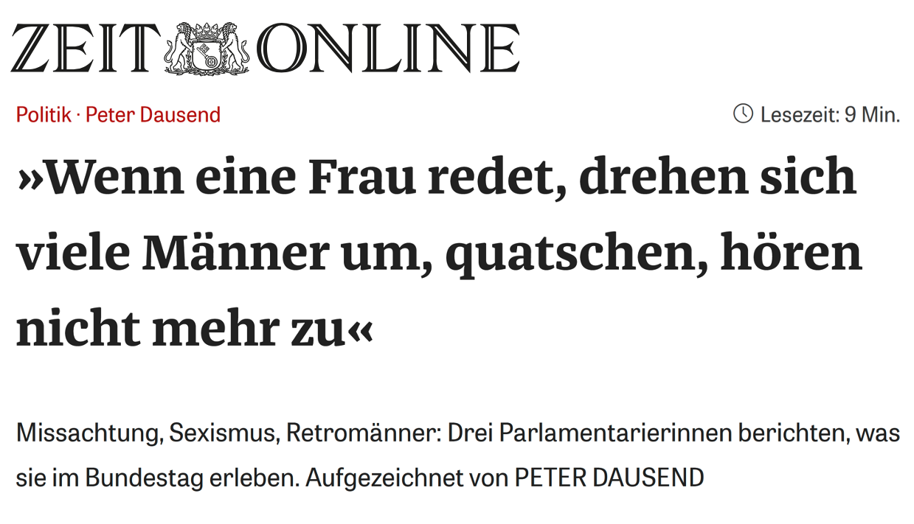
”When a woman speaks, many men turn around, chat, and stop listening”

Slide 3
Research question:
Do parliamentary speeches by women legislators receive less attention than speeches by men legislators?

Slide 4
Underrepresentation of women in politics
Supply:
Political ambition
Fox & Lawless (2005)
Persistence
Bernhard & de Benediktis-Kessner (2021)
Behaviour
within institutions
Anzia & Berry (2011)
Dietrich et al. (2019)
Descriptive
representation
(numerical representation)
Substantive
representation
(policy outcomes)
Inequalities
within institutions
Erikson & Josefsson (2019)
Krook (2018)
Kerevel & Atkeson (2013)
Demand:
Voter discrimination
Clayton et al. (2020)
Party discrimination
Fujiwara et al. (2025)
Institutional factors
Dahlerup & Freidenvall (2005)
Our focus:
Attention inequalities as a barrier to
women’s equitable participation in parliament

Slide 5
Gender inequalities within parliaments
Attention is difficult to study!
Attention is a subtle non-verbal behaviour
We are aware of it, but there is no formal documentation
  Lack of data sources
  Lack of measurement tools

Slide 6
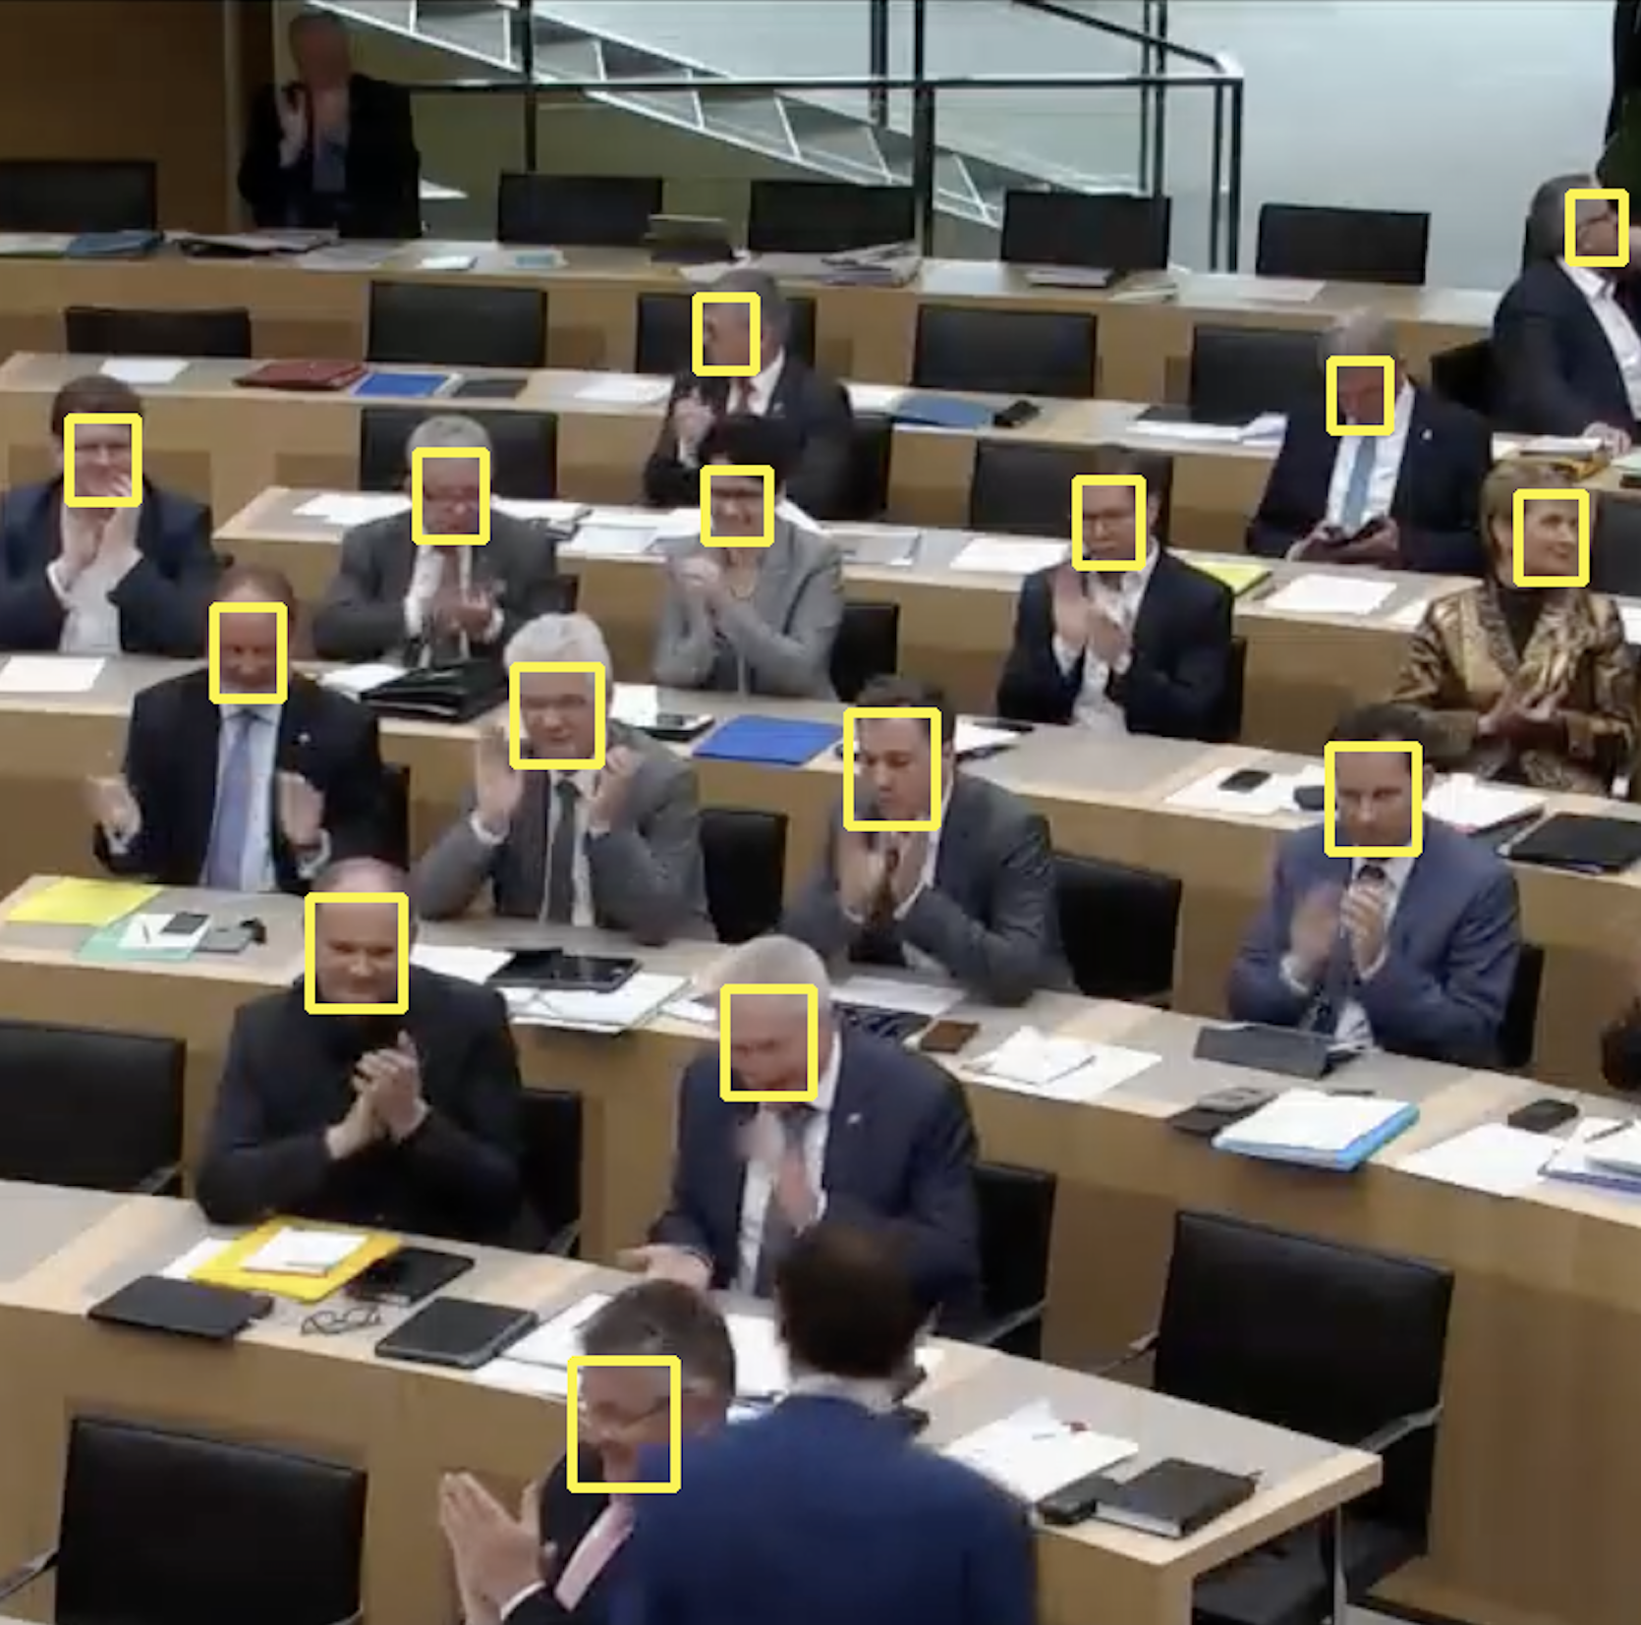
Making audience attention measurable
Data: Video footage from TV cameras installed in parliament
Measurement of attention: Computational video analysis
Preview of the results:
  Women receive less attention than men, on average
  This difference is driven by men in the audience
  Women pay equal attention to both their men and women colleagues

Slide 7
Progress, but more to learn
Limitations
  Evidence from one specific case, limited time frame
  Democratic deliberation often happens before parliamentary debates
  Downstream consequences of the gender attention gap remain unclear
Contributions
  New computational video analysis pipeline to measure audience attention
  First non-anecdotal evidence on the gender attention gap

Slide 8
Measuring and analysing parliamentary attention
Data: Video footage from parliamentary television cameras
Measurement: Computational video analysis pipeline
Results: Gender attention gap
Conclusion: Summary and contributions

Slide 9
Data:
Video footage from parliamentary television cameras

Slide 10
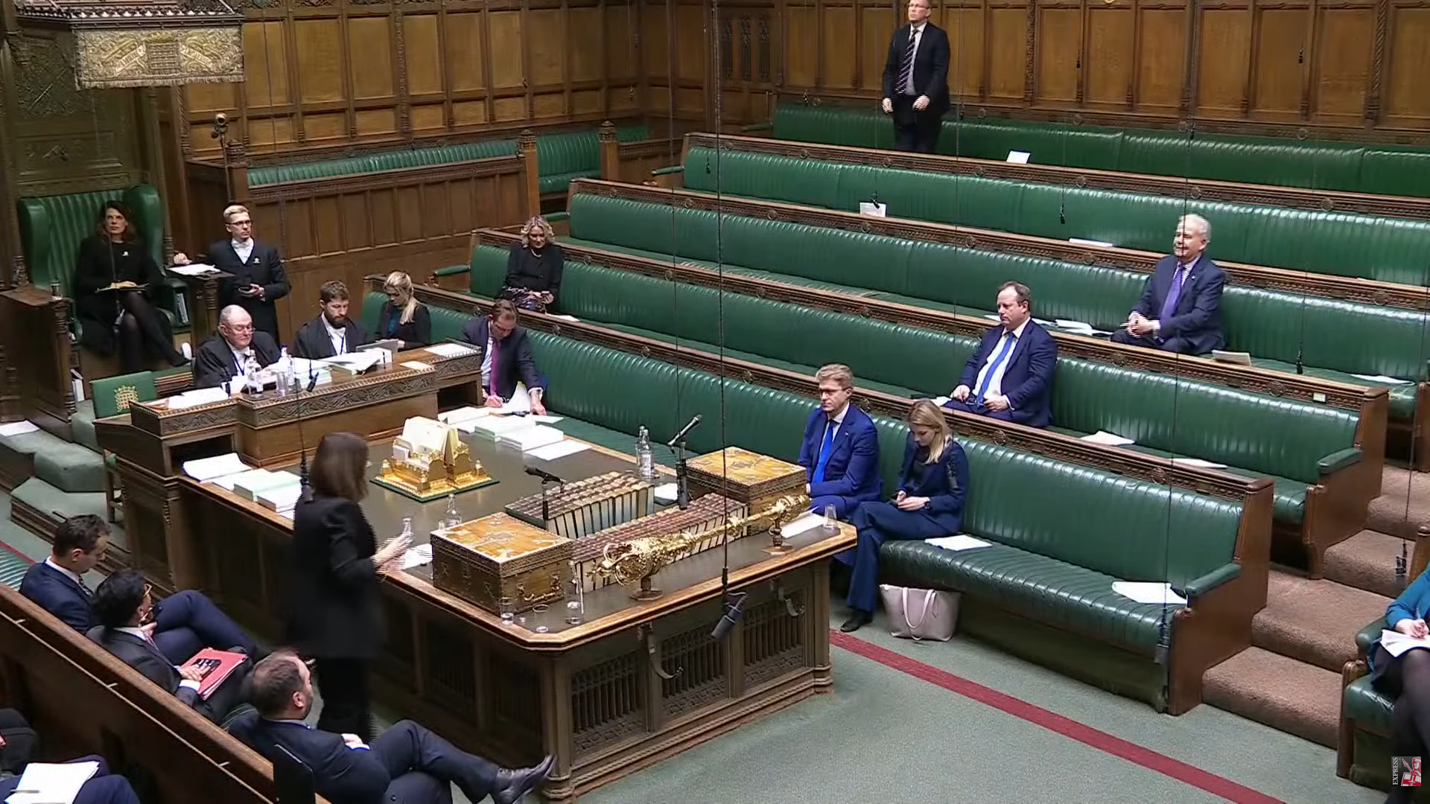
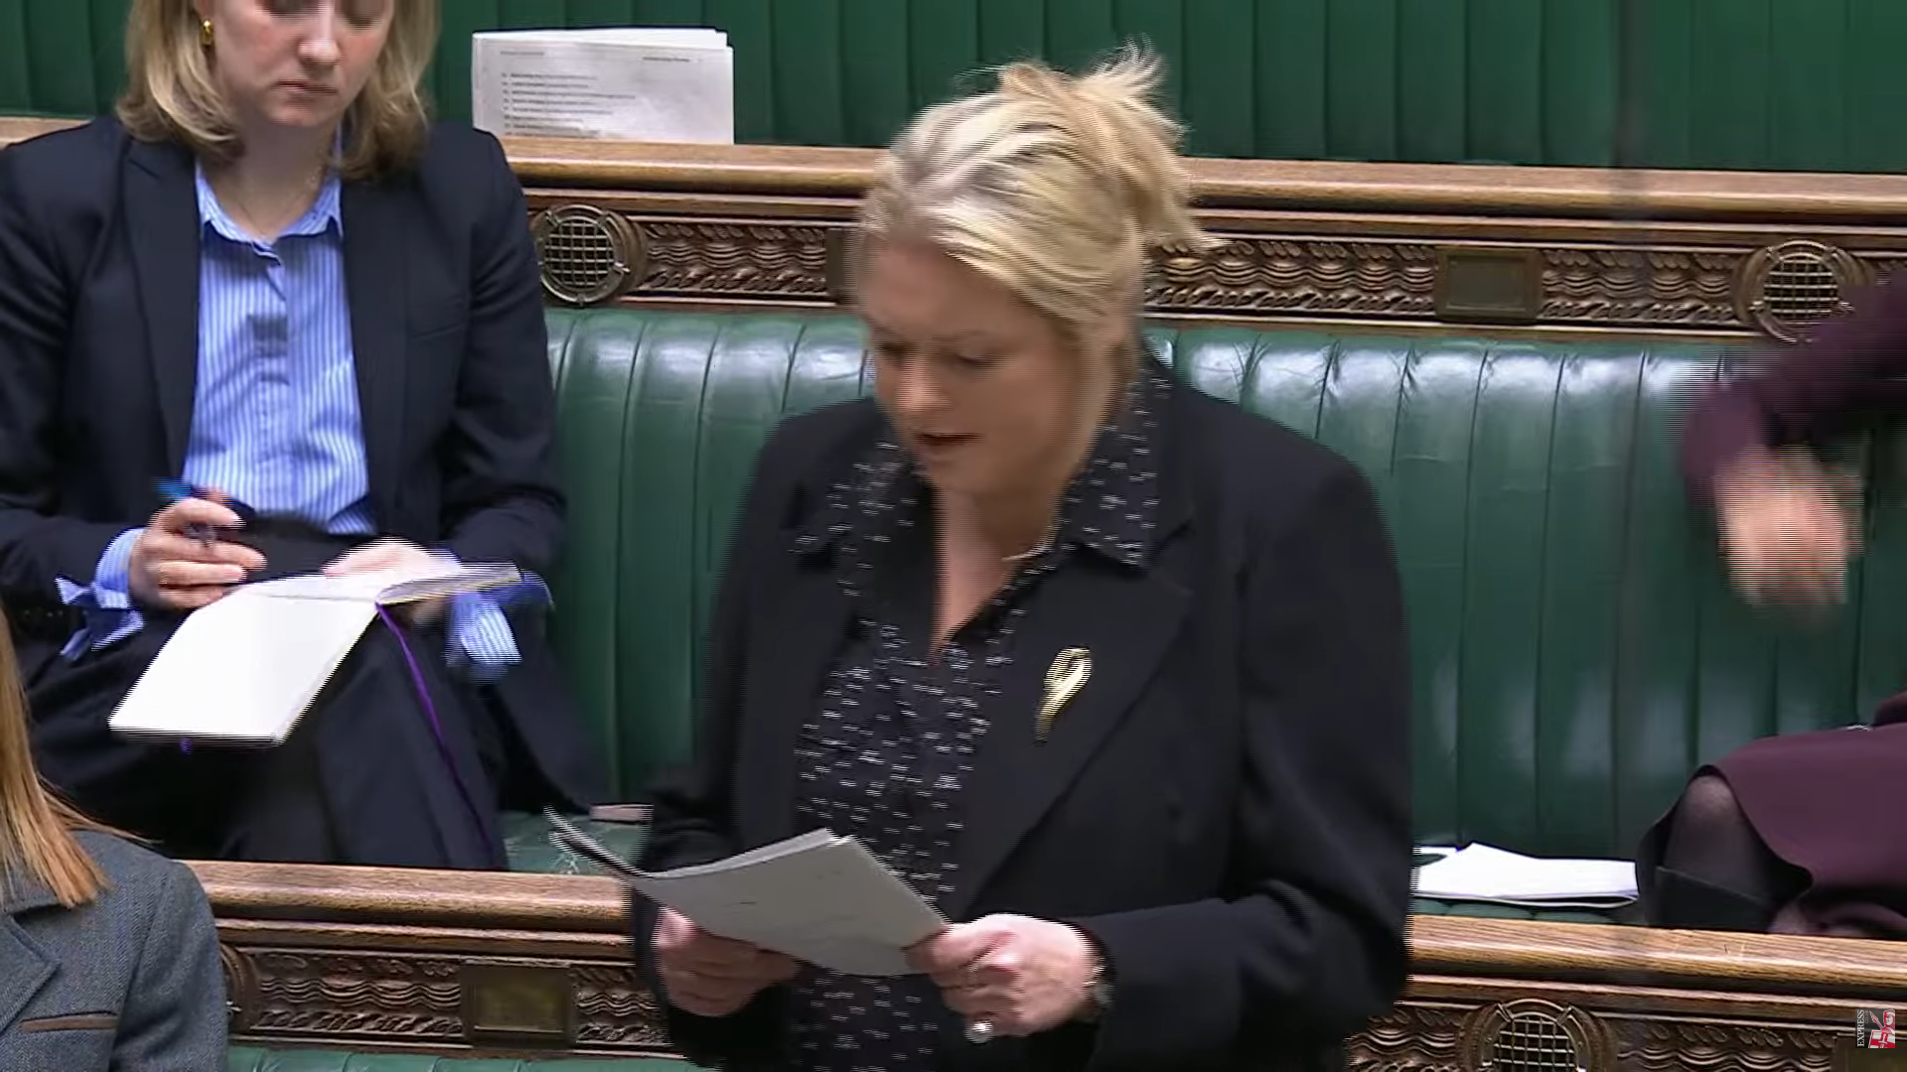
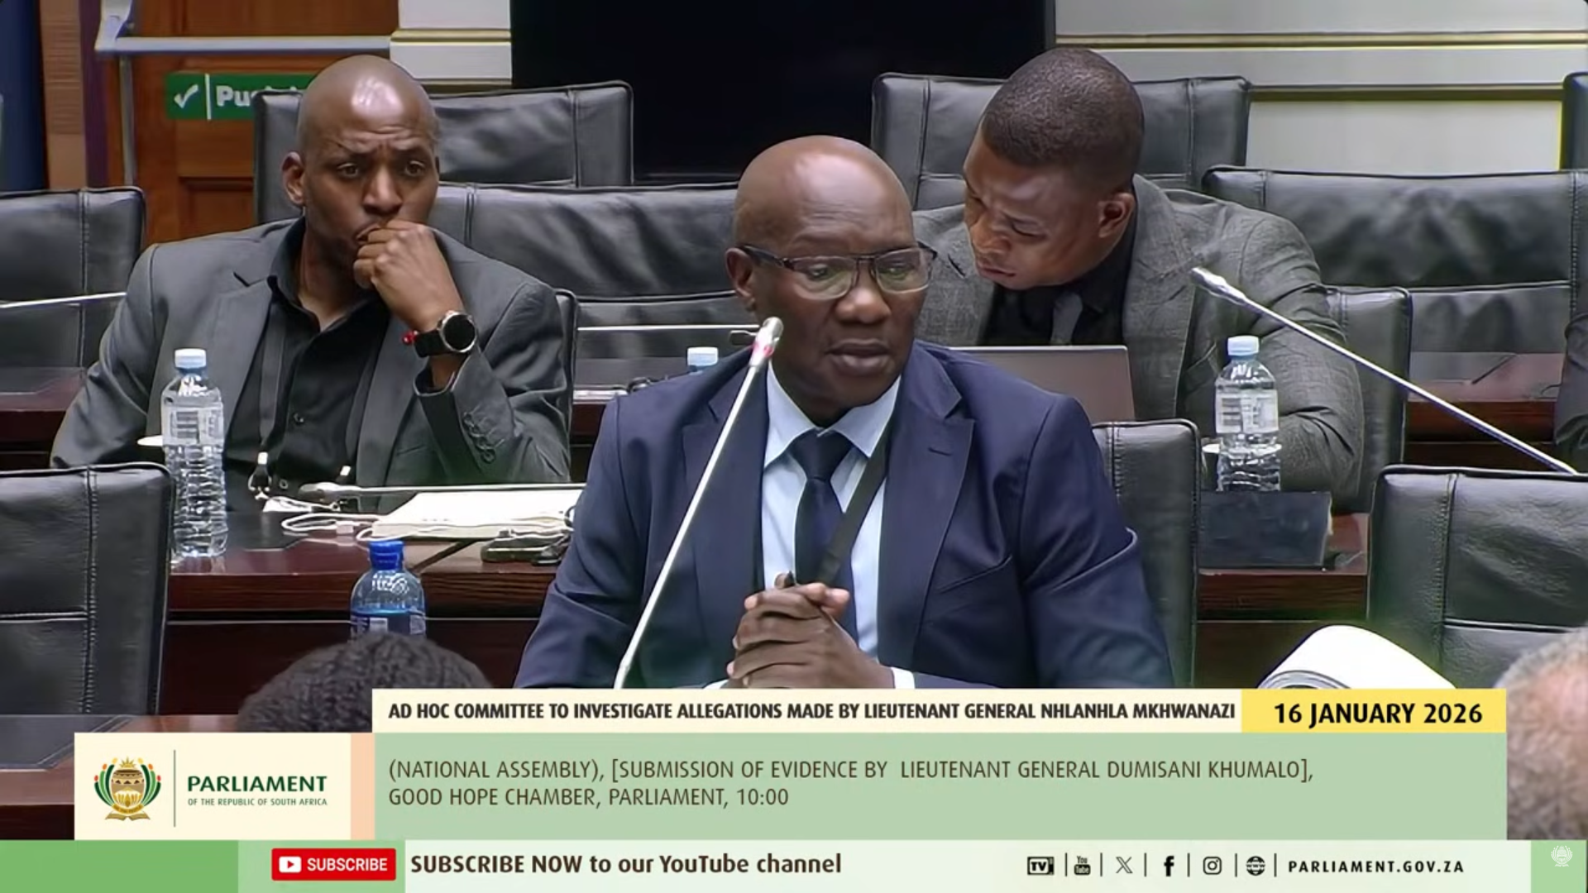
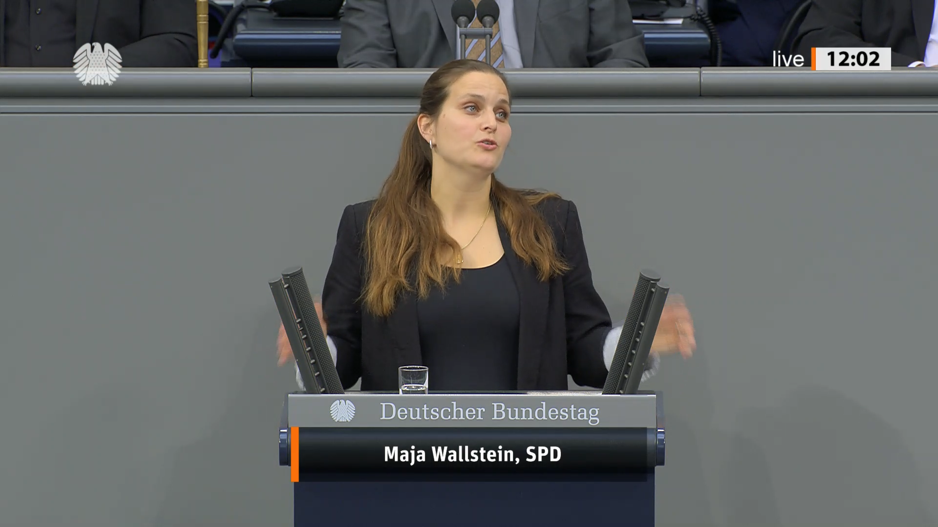
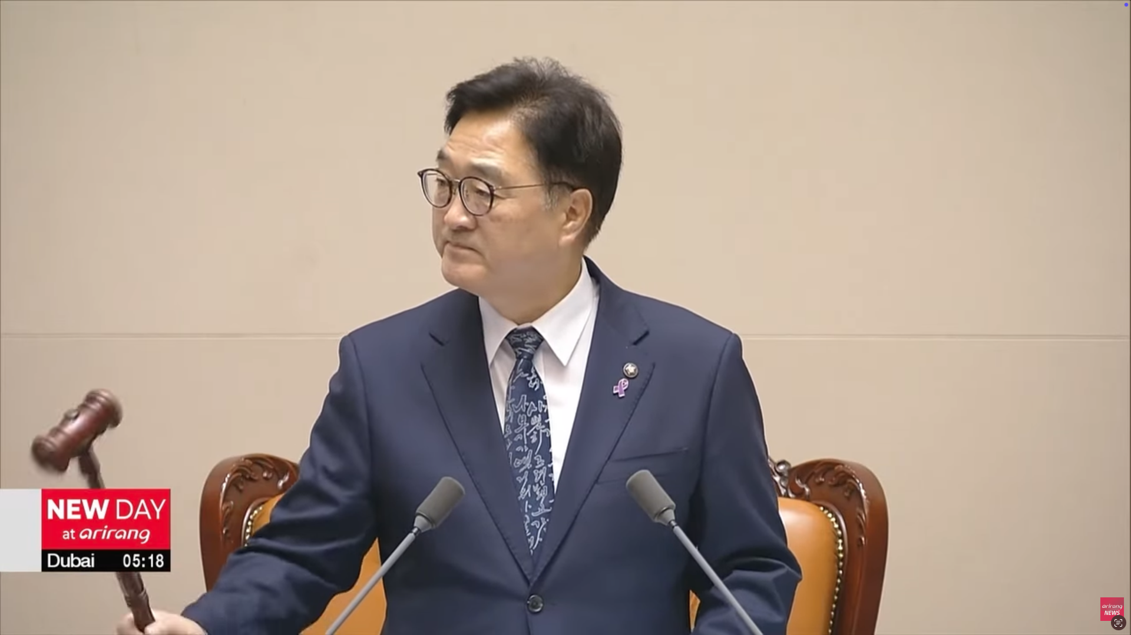
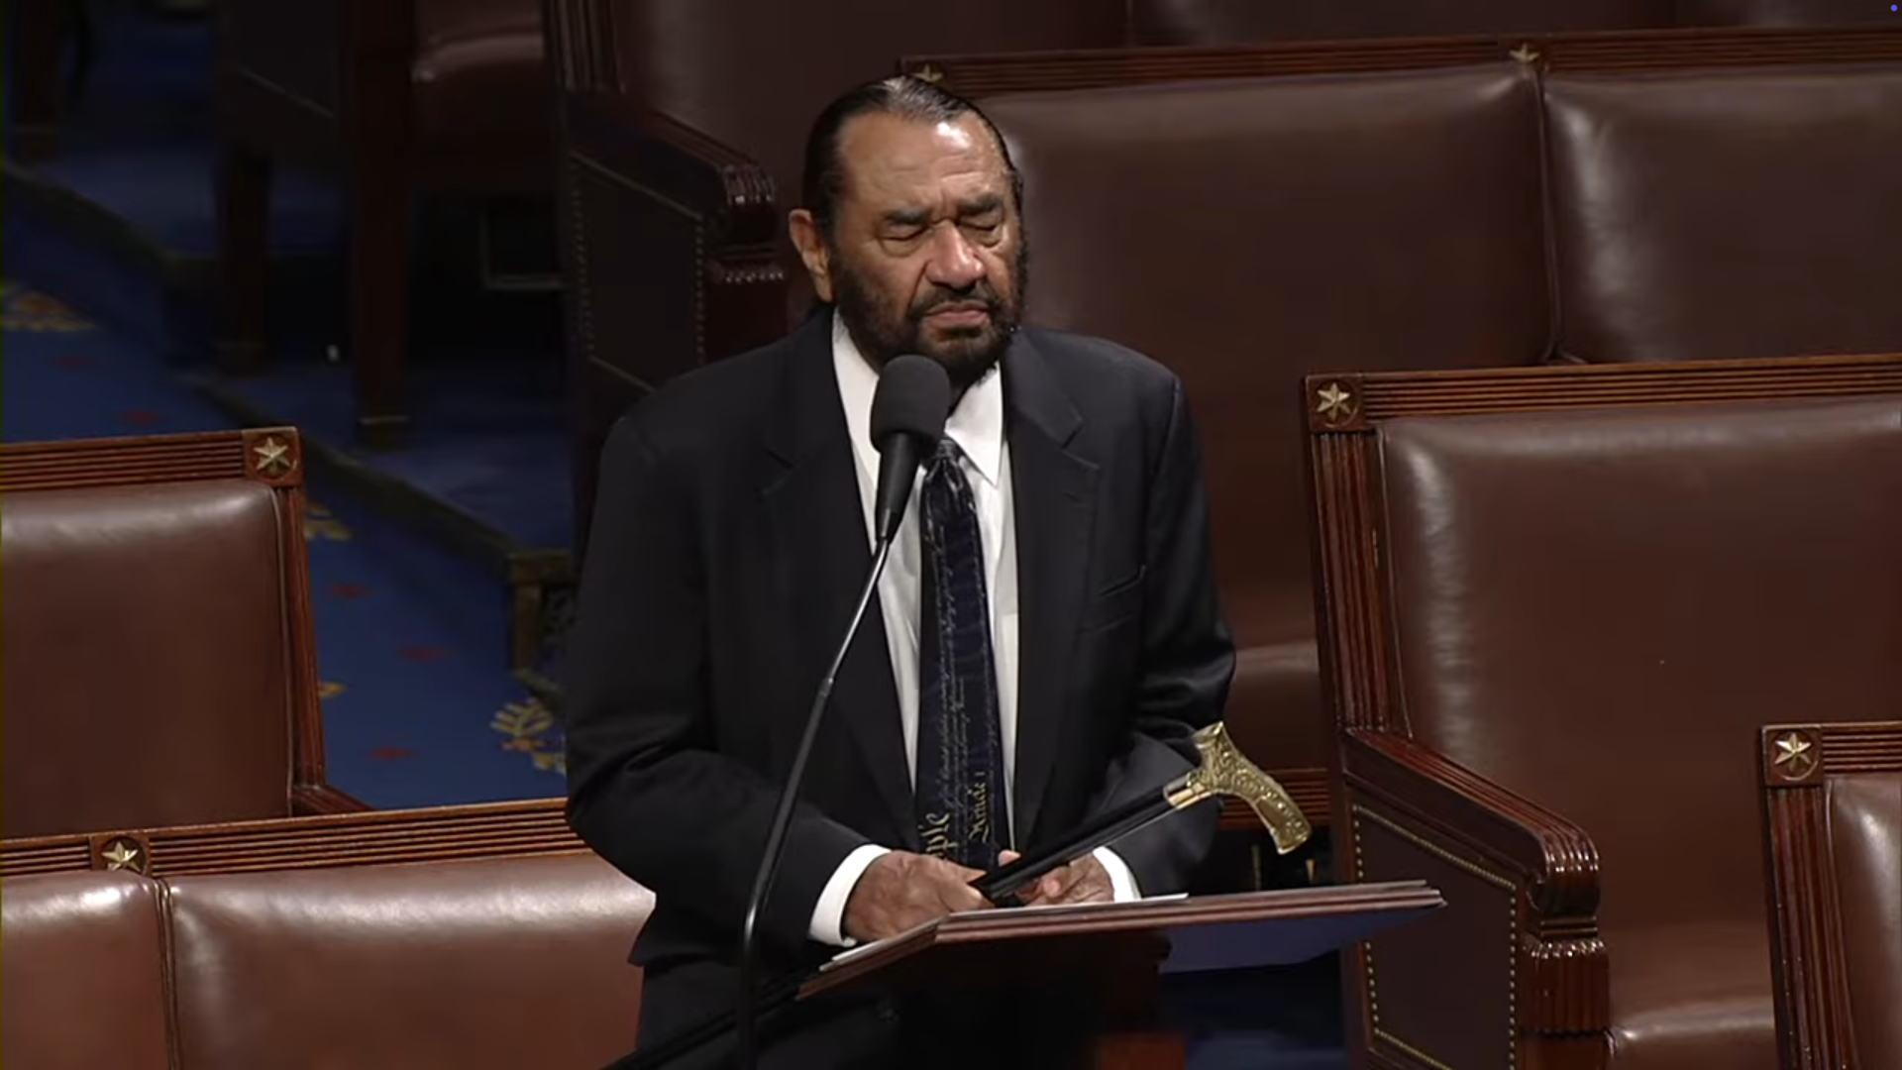
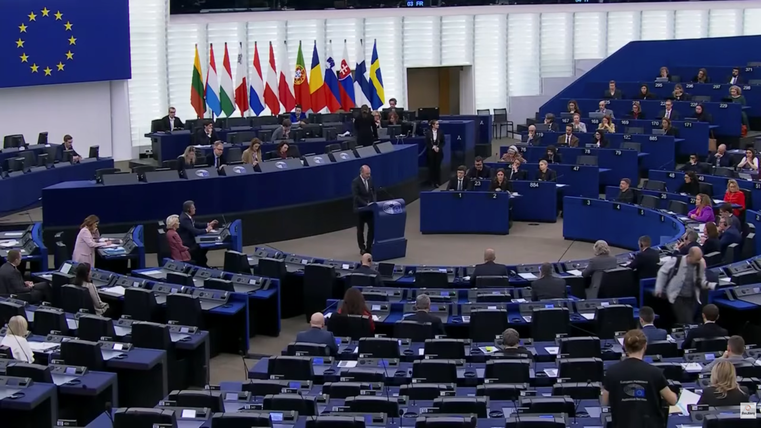
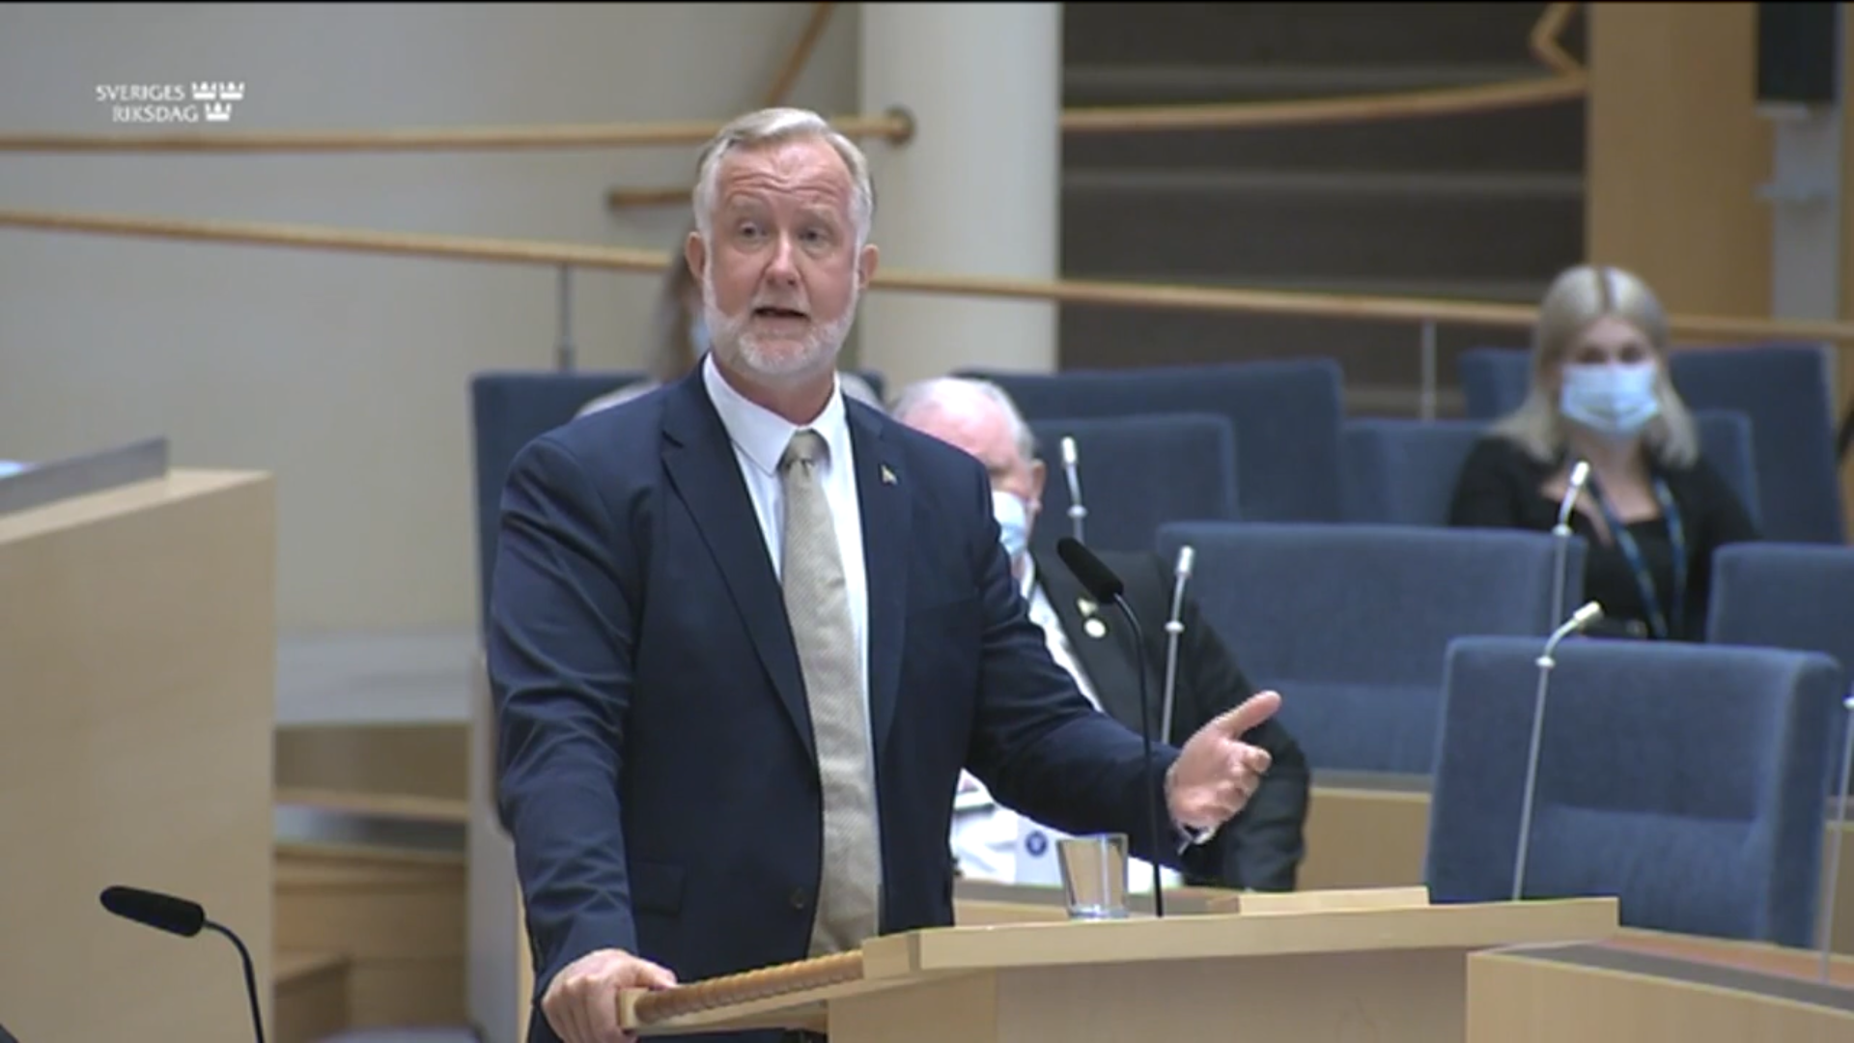
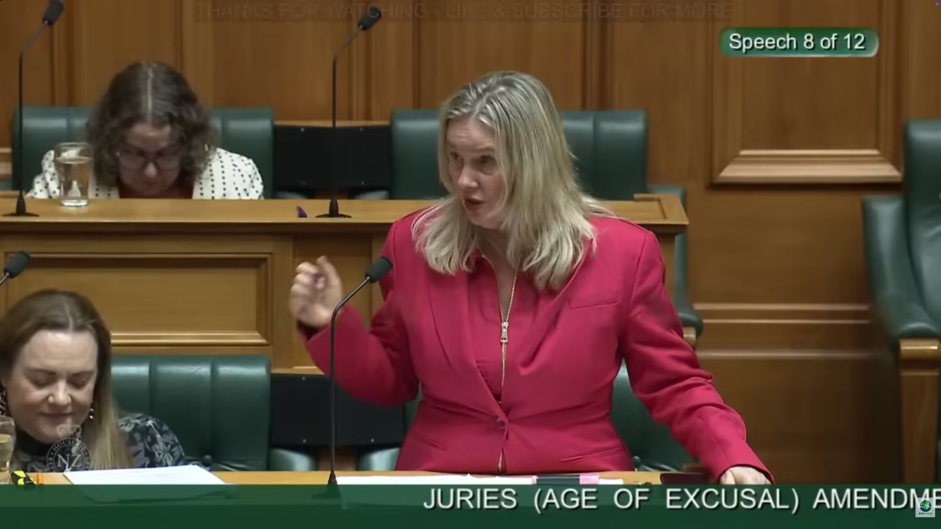
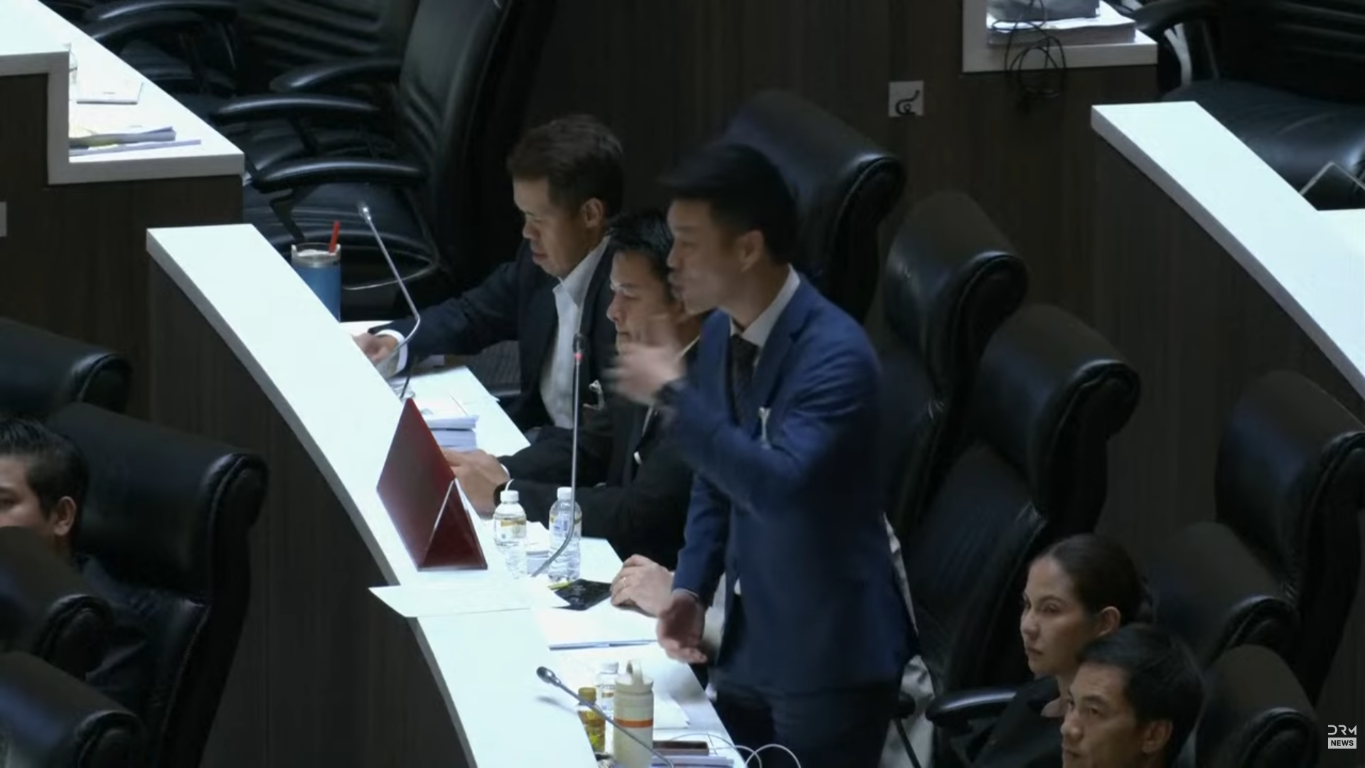
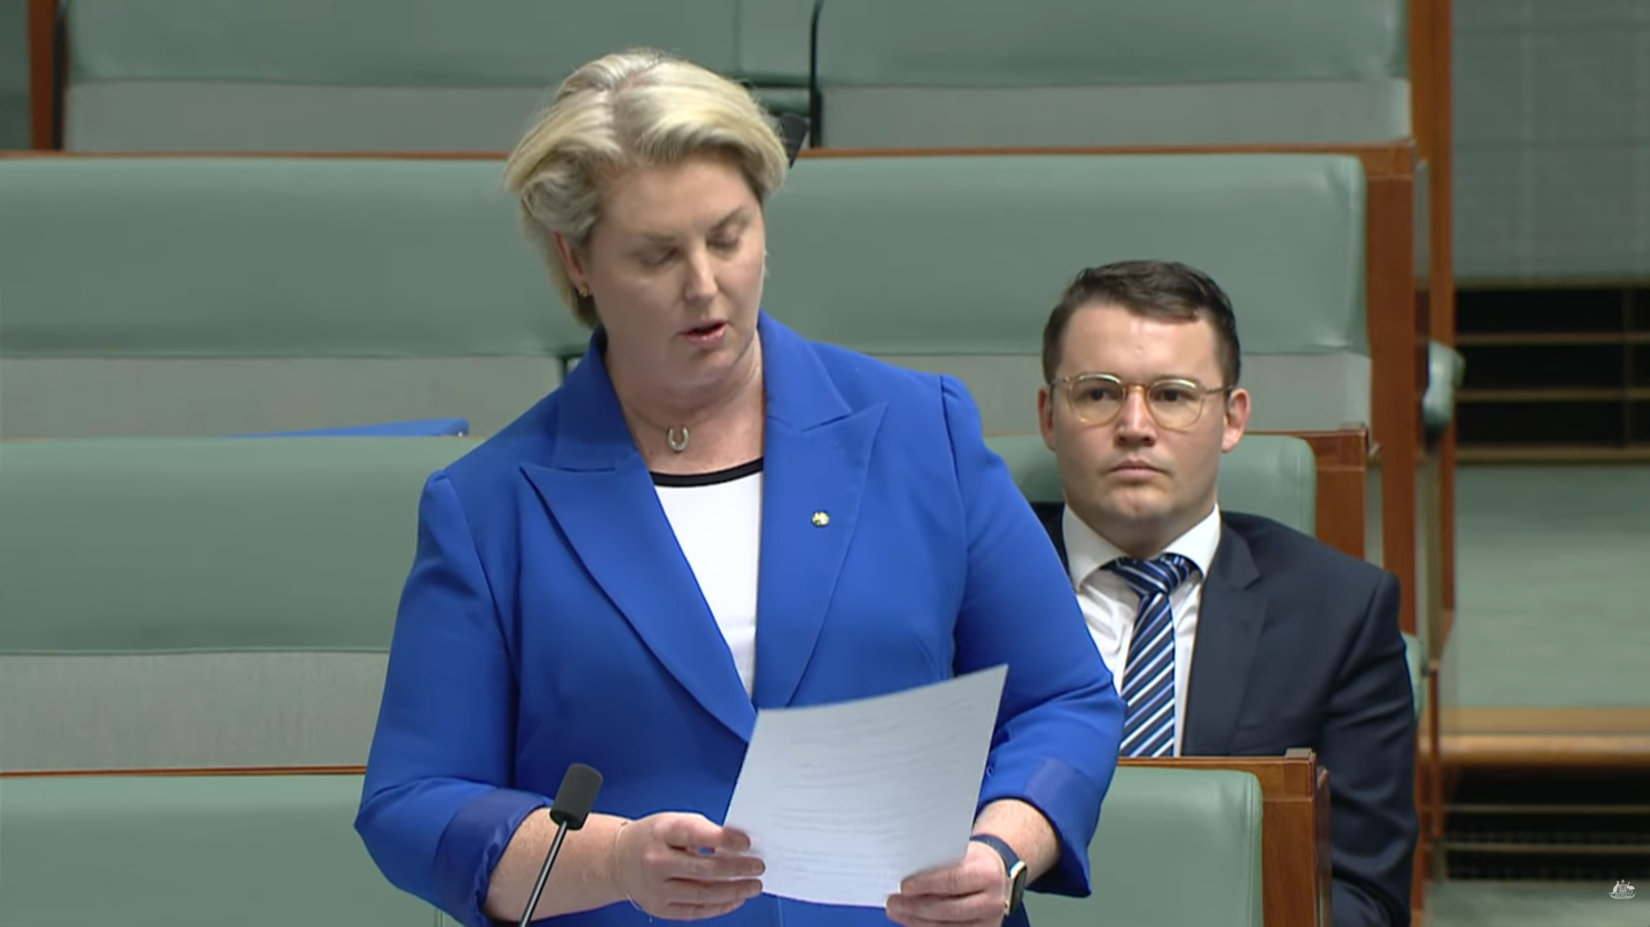
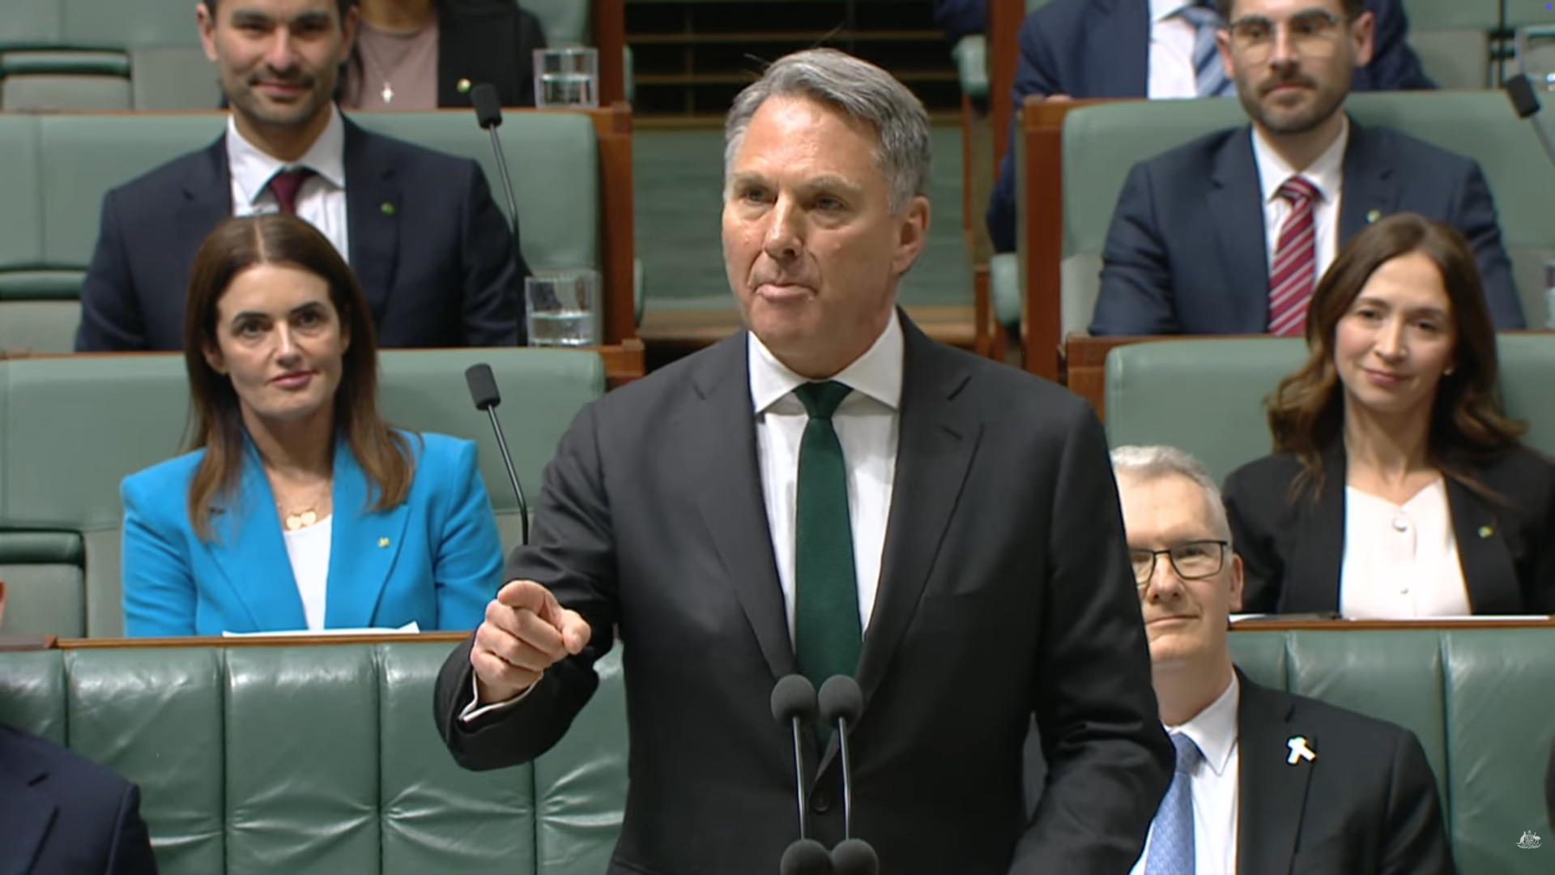
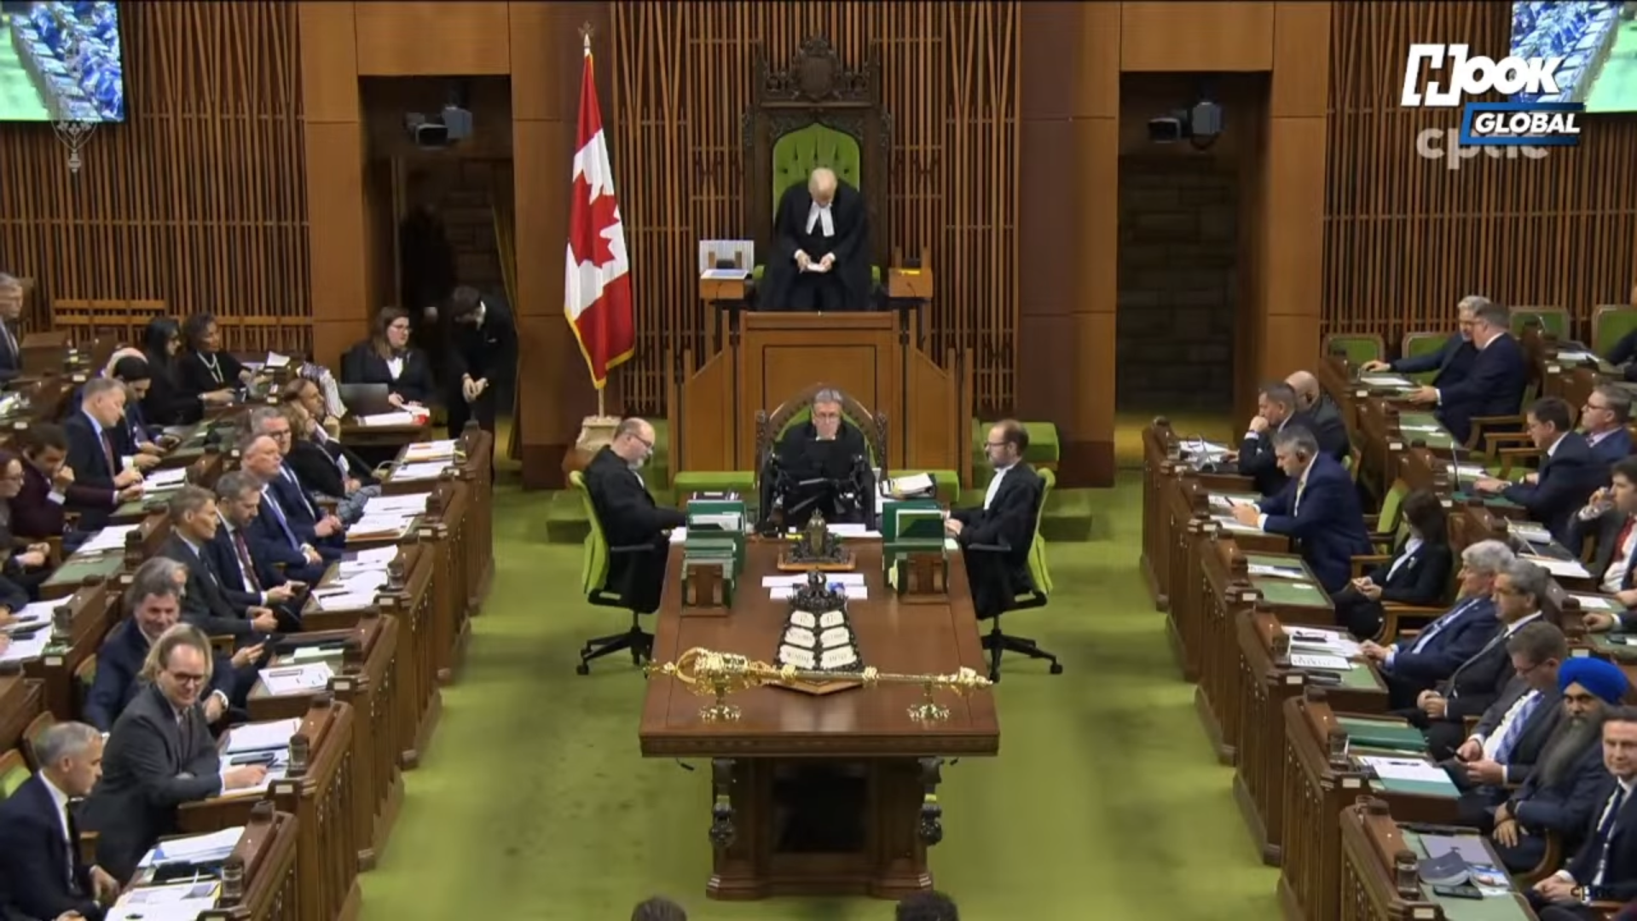


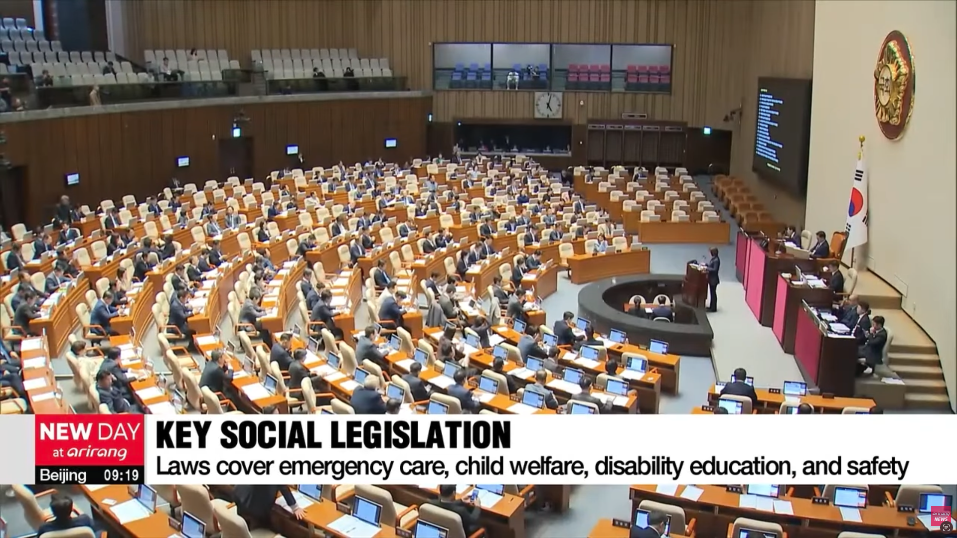
Parliaments around the world publish video recordings of their parliamentary debates
But: Mostly show the speaker, not the audience
To study audience attention, we need recordings of the audience

Slide 11
Video footage Landtag Baden-Württemberg
Case:
Landtag BW, German state-level parliament

Slide 12
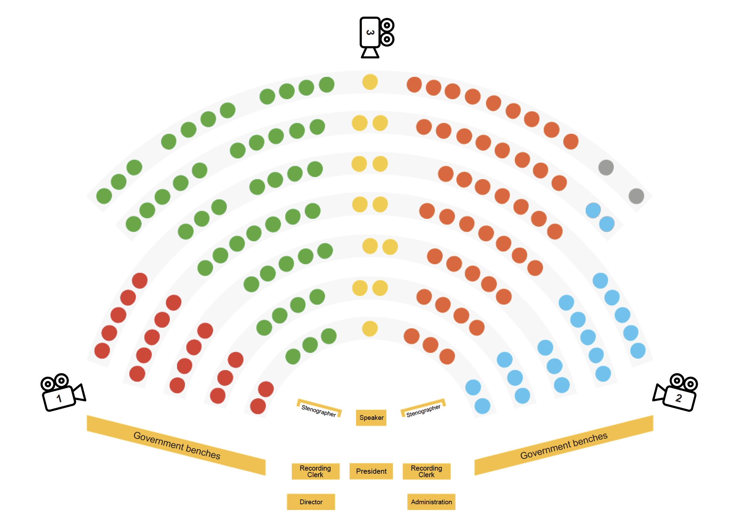
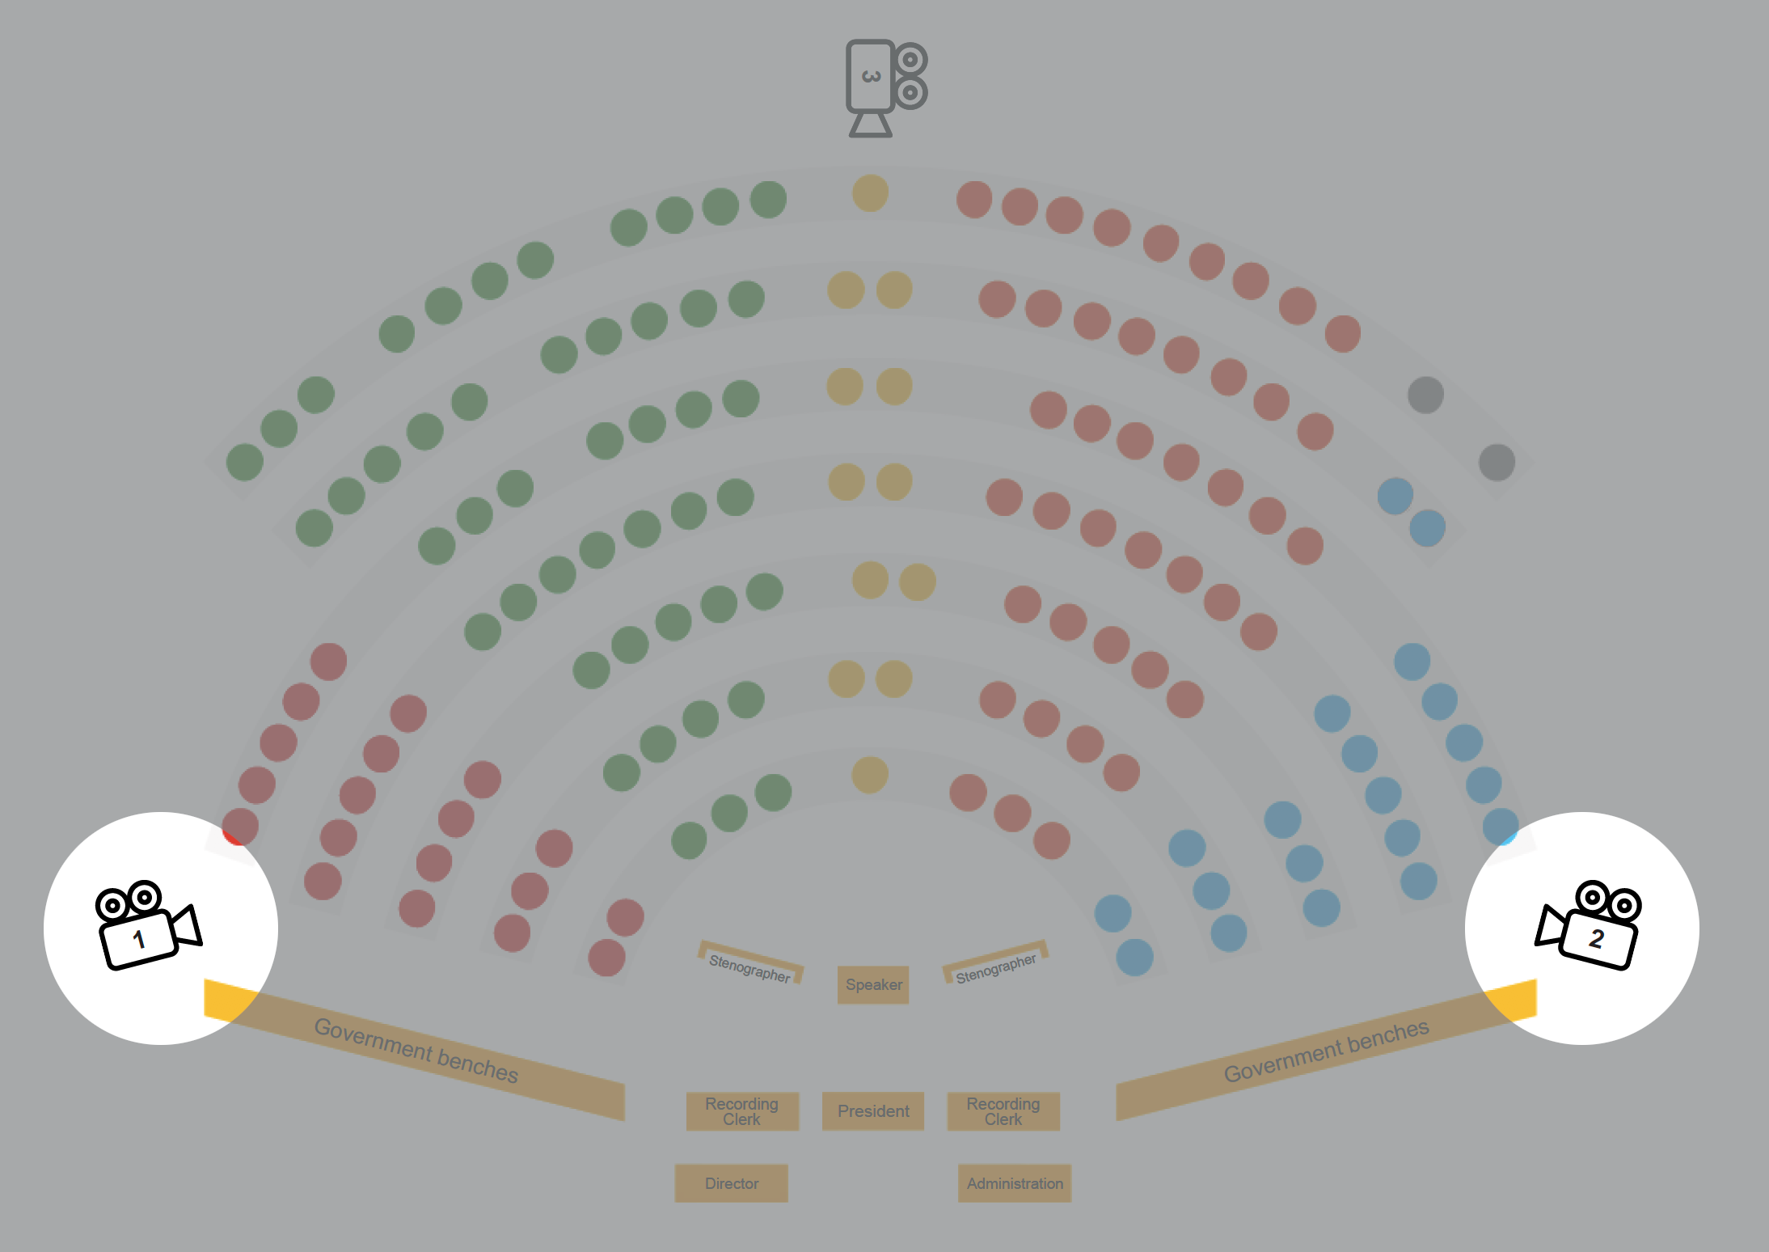
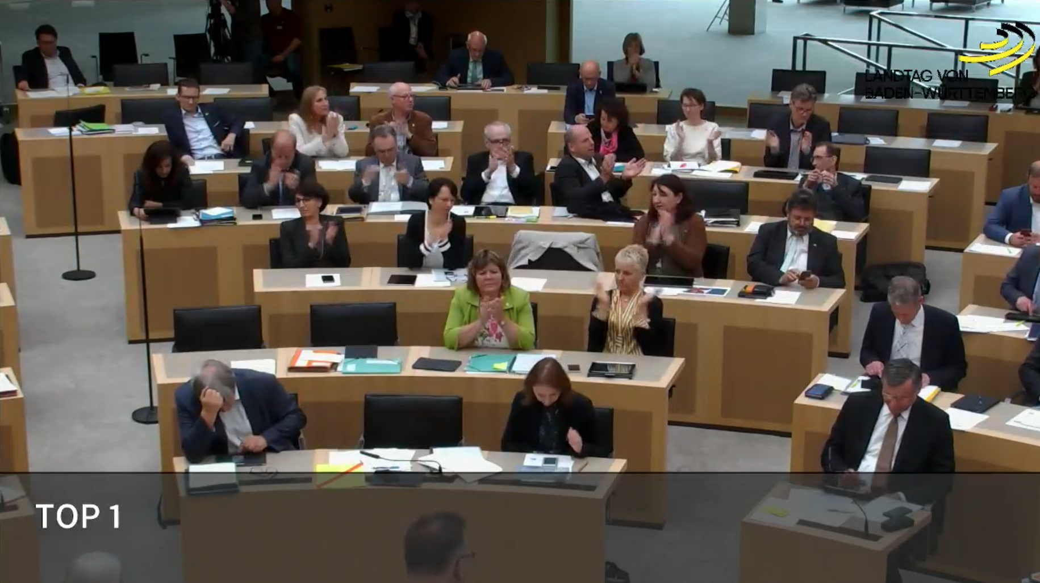
Video footage Landtag Baden-Württemberg

Slide 13
Video footage Landtag Baden-Württemberg
Case:
Landtag BW, German state-level parliament
Unedited video data: Cooperation with local broadcaster SWR
Video corpus: one year of plenary sessions (July 2018 to July 2019)
  30 session days
  142 debates
  1,003 speeches

Slide 14
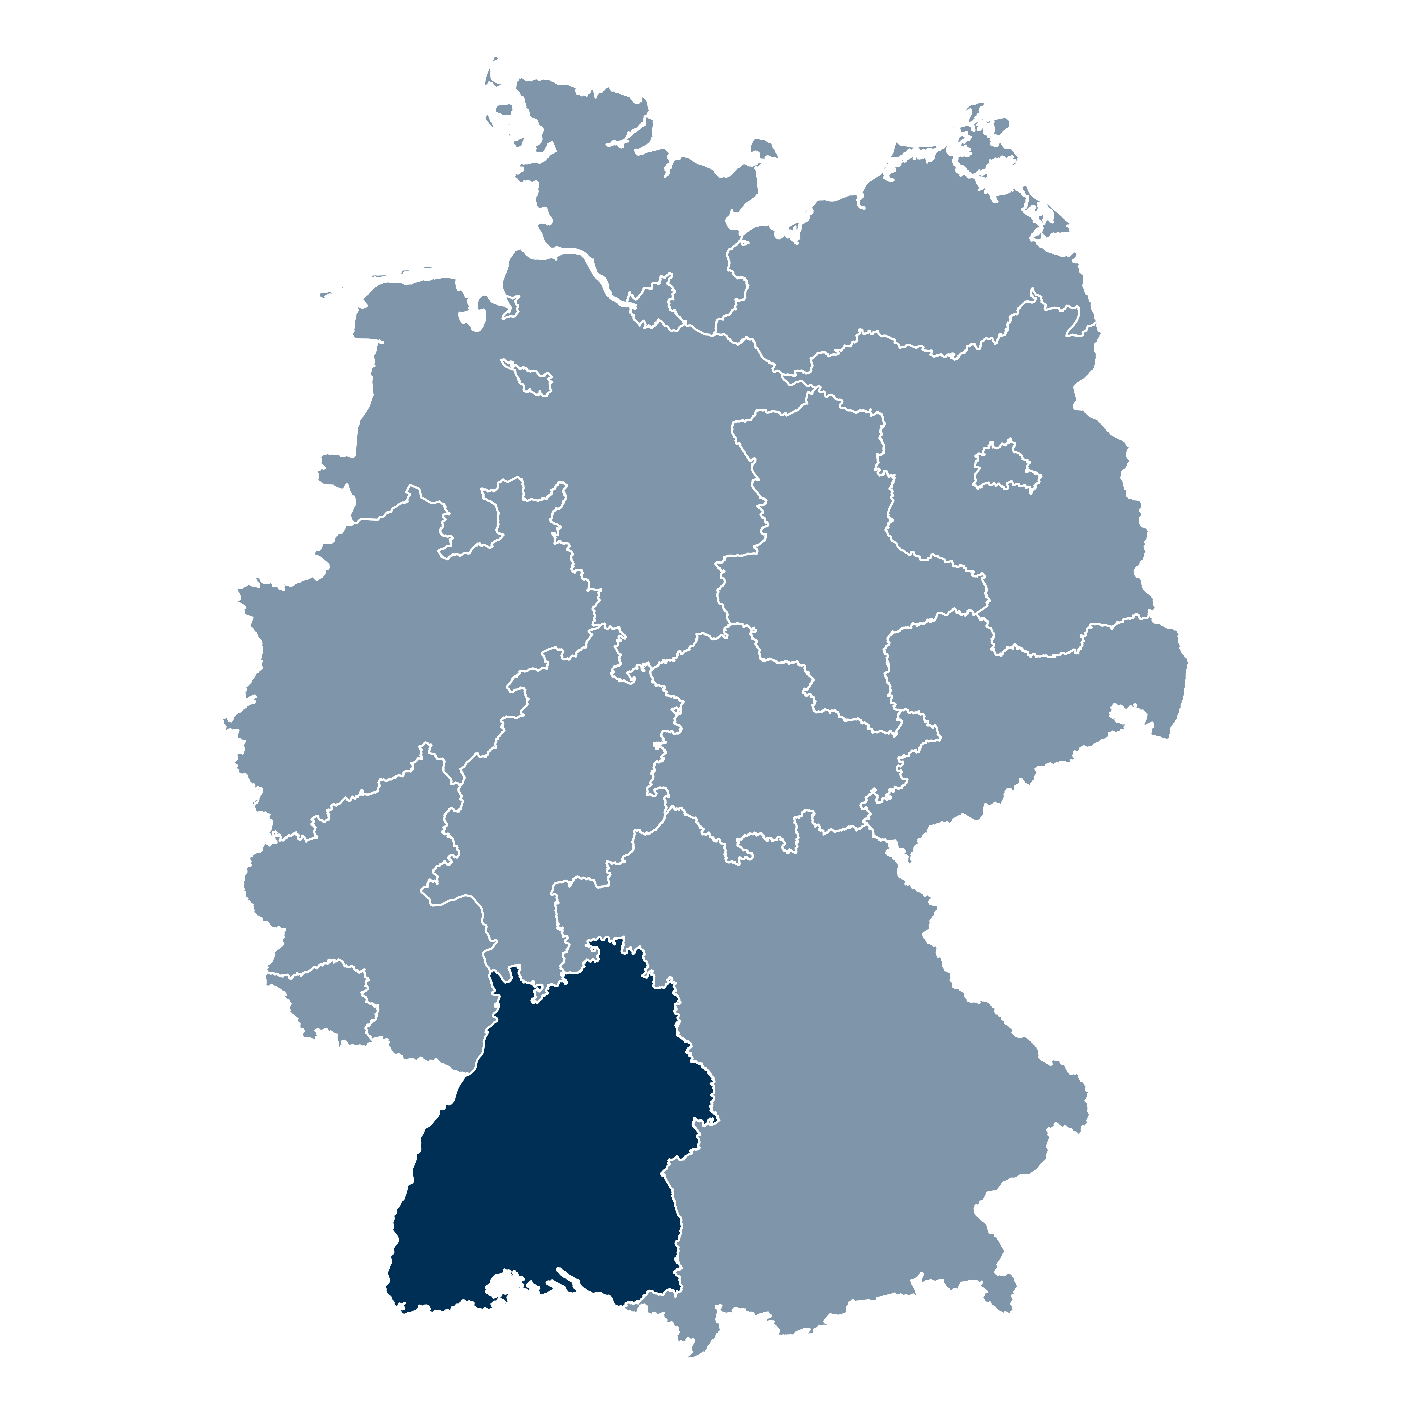
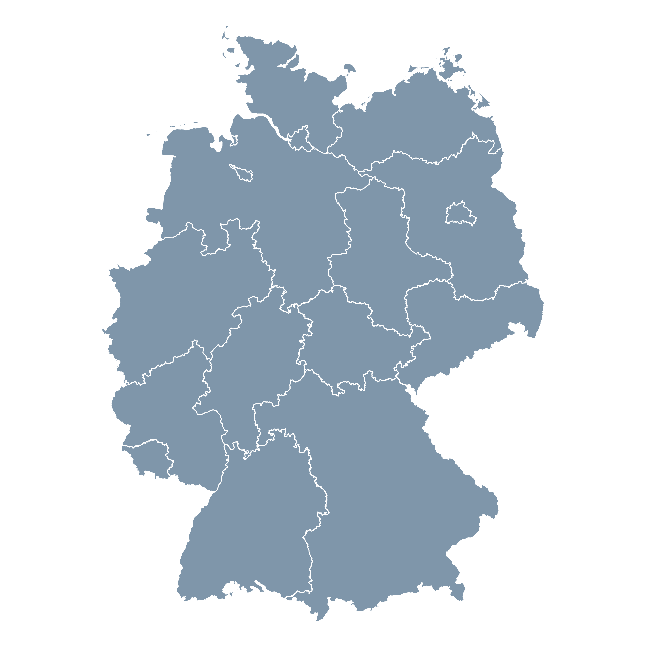
Case: Landtag Baden-Württemberg 2018/19
143 seats
Five party groups:
  Green Party (47 seats, 32.9%)
  Christian Democrats (43 seats, 31.1%)
  AfD (20 seats, 14.0%)
  Social Democrats (19 seats, 13.3%)
  Liberals (12 seats, 8.4%)
Governing coalition:
Greens and Christian Democrats

Slide 15
Case: Landtag Baden-Württemberg 2018/19
Share of women: 25.8%,
But highly unequal between parties:
  Green Party: 22/47 (46.8%)
  Christian Democrats: 10/43 (23.3%)
  AfD: 2/20 (10.0%)
  Social Democrats 2/19 (10.5%)
  Liberals: 1/12 (8.3%)

Slide 16
Measurement:
Using computer vision to measure attention in parliament

Slide 17
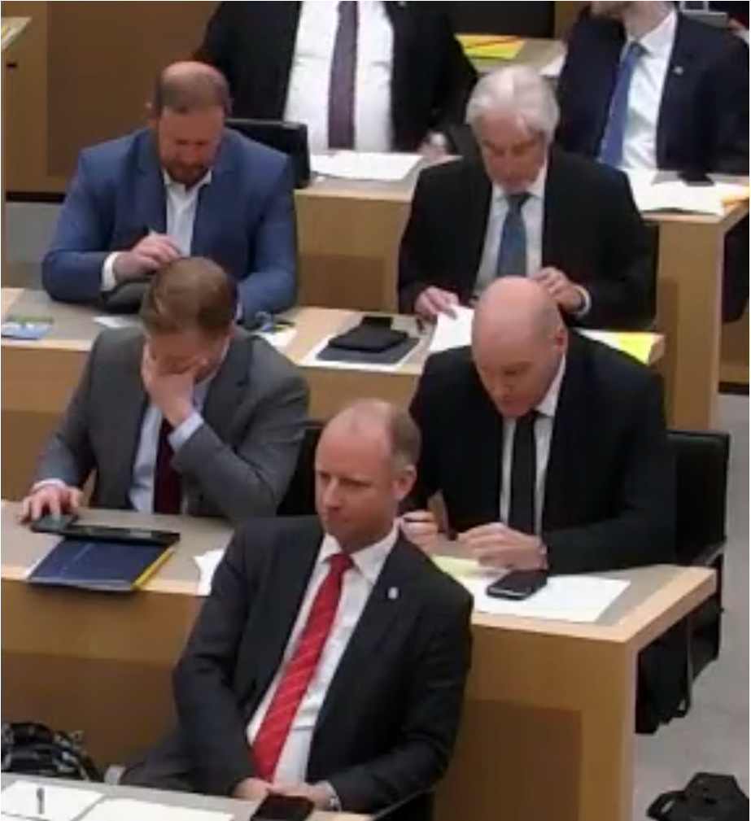
Three goals of measurement
Face detection
Face recognition
Attention classification
✗
✗
Legislator A
Legislator B
✗
✗
✓
Legislator C
Legislator D
Legislator E

Slide 18
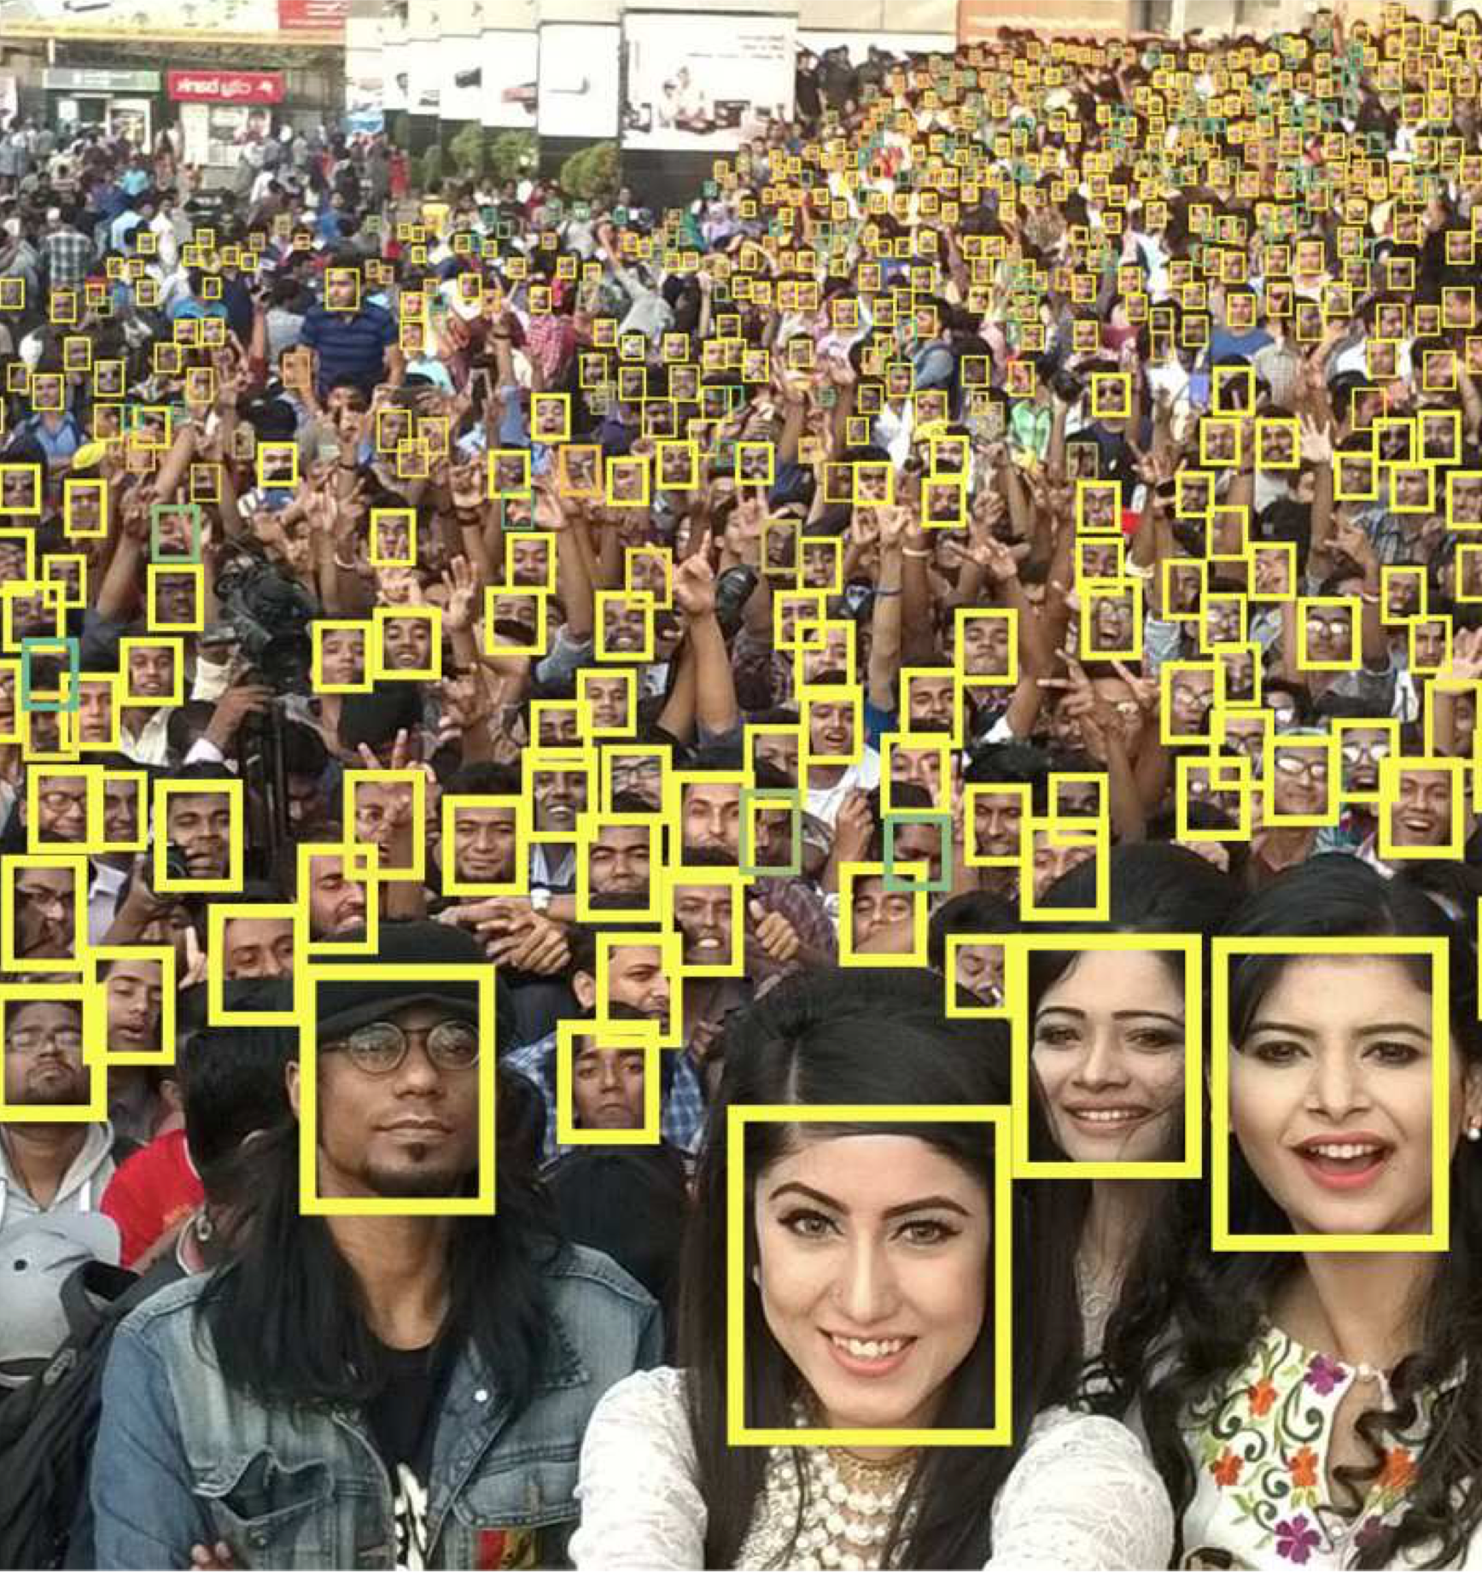
Measuring attention in parliament
Face detection: Detect faces in the video
  TinyFace architecture (Hu and Ramanan, 2017)
TinyFace application
(Hu and Ramanan, 2017)
TinyFace application
Landtag BW

Slide 19
Measuring attention in parliament
Face detection: Detect faces in the video
Face recognition: Identify legislators based on their face
  One of the most deeply studied areas in computer vision in the past decades
  Convolutional Neural Network (CNN) to predict the identity of legislators based on detected faces

Slide 20
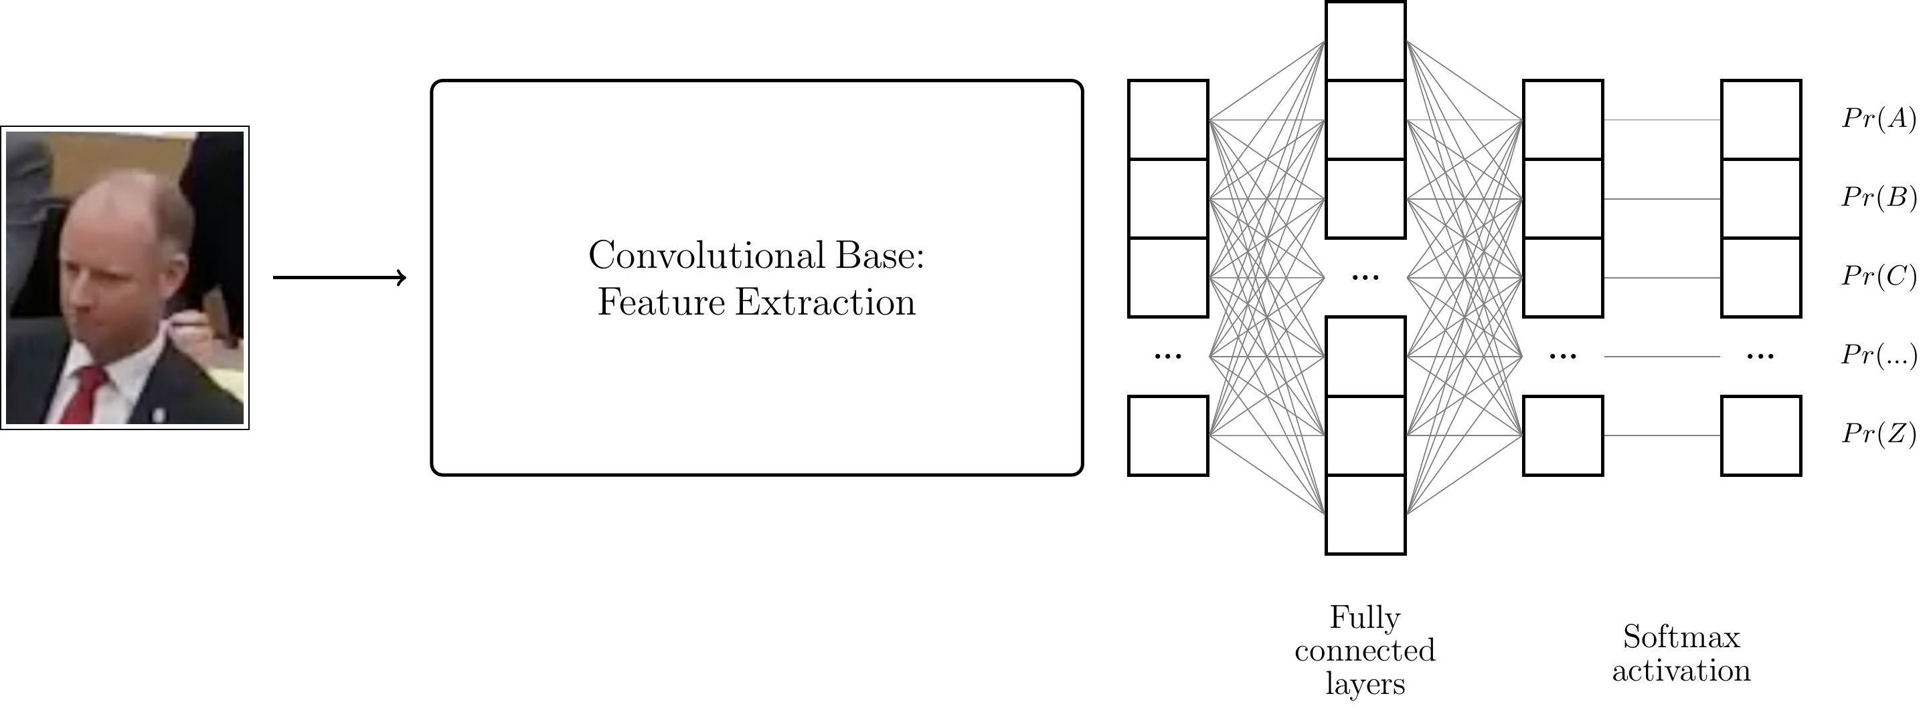
Measuring attention in parliament
Face detection: Detect faces in the video
Face recognition: Identify legislators based on their face

Slide 21
Measuring attention in parliament
Face detection: Detect faces in the video
Face recognition: Identify legislators based on their face
  One of the most deeply studied areas in computer vision in the past decades
  Convolutional Neural Network (CNN) to predict the identity of legislators based on detected faces
  Training data set based on both photos and video clips of all legislators in the Landtag
  Transfer learning approach:
  ResNet-18 pre-trained on ImageNet data set and fine-tuned with the legislator data set (He et al., 2016; Deng et al., 2009)
  Performance: 99.7% correct classification on test set (true-positive rate)
  [details⎘]

Slide 22
Measuring attention in parliament
Face detection: Detect faces in the video
Face recognition: Identify legislators based on their face
Attention classification: Classify faces as attentive or not attentive
  Training data: ~46.000 images annotated by four coders

Slide 23
Measuring attention in parliament
Face detection: Detect faces in the video
Face recognition: Identify legislators based on their face
Attention classification: Classify faces as attentive or not attentive
  Training data: ~46.000 images annotated by four coders
  ResNet-34 pre-trained ImageNet data set and fine-tuned with labelled training data to classify images as attentive or not attentive
  (He et al, 2016; Deng et al., 2009)
  Performance: 88.6% (13 out of 15) image frames correctly classified [details⎘]

Slide 24
Measuring attention in parliament
Analysis of one year of plenary sessions (July 2018 to July 2019)
Unit of observation: Speaker-listener dyad
  > 25,000 observation
For each speech and each listening legislator:
Dependent Variable = Share of attentive frames during a speech
[details⎘]

Slide 25
Results:
Do women receive less attention than men?

Slide 26
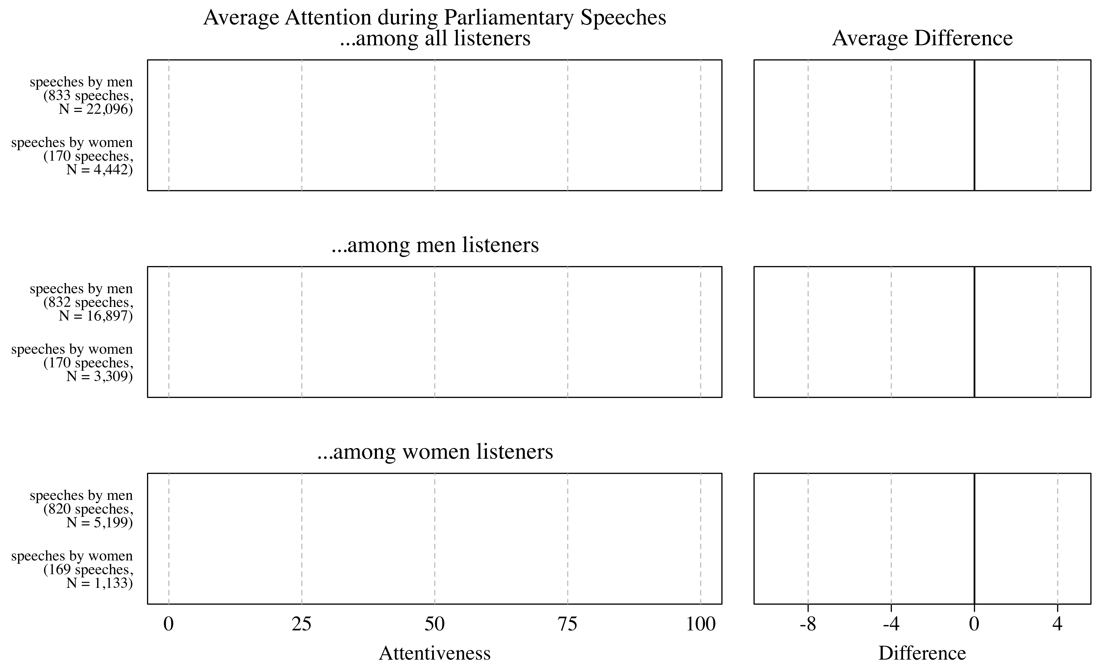
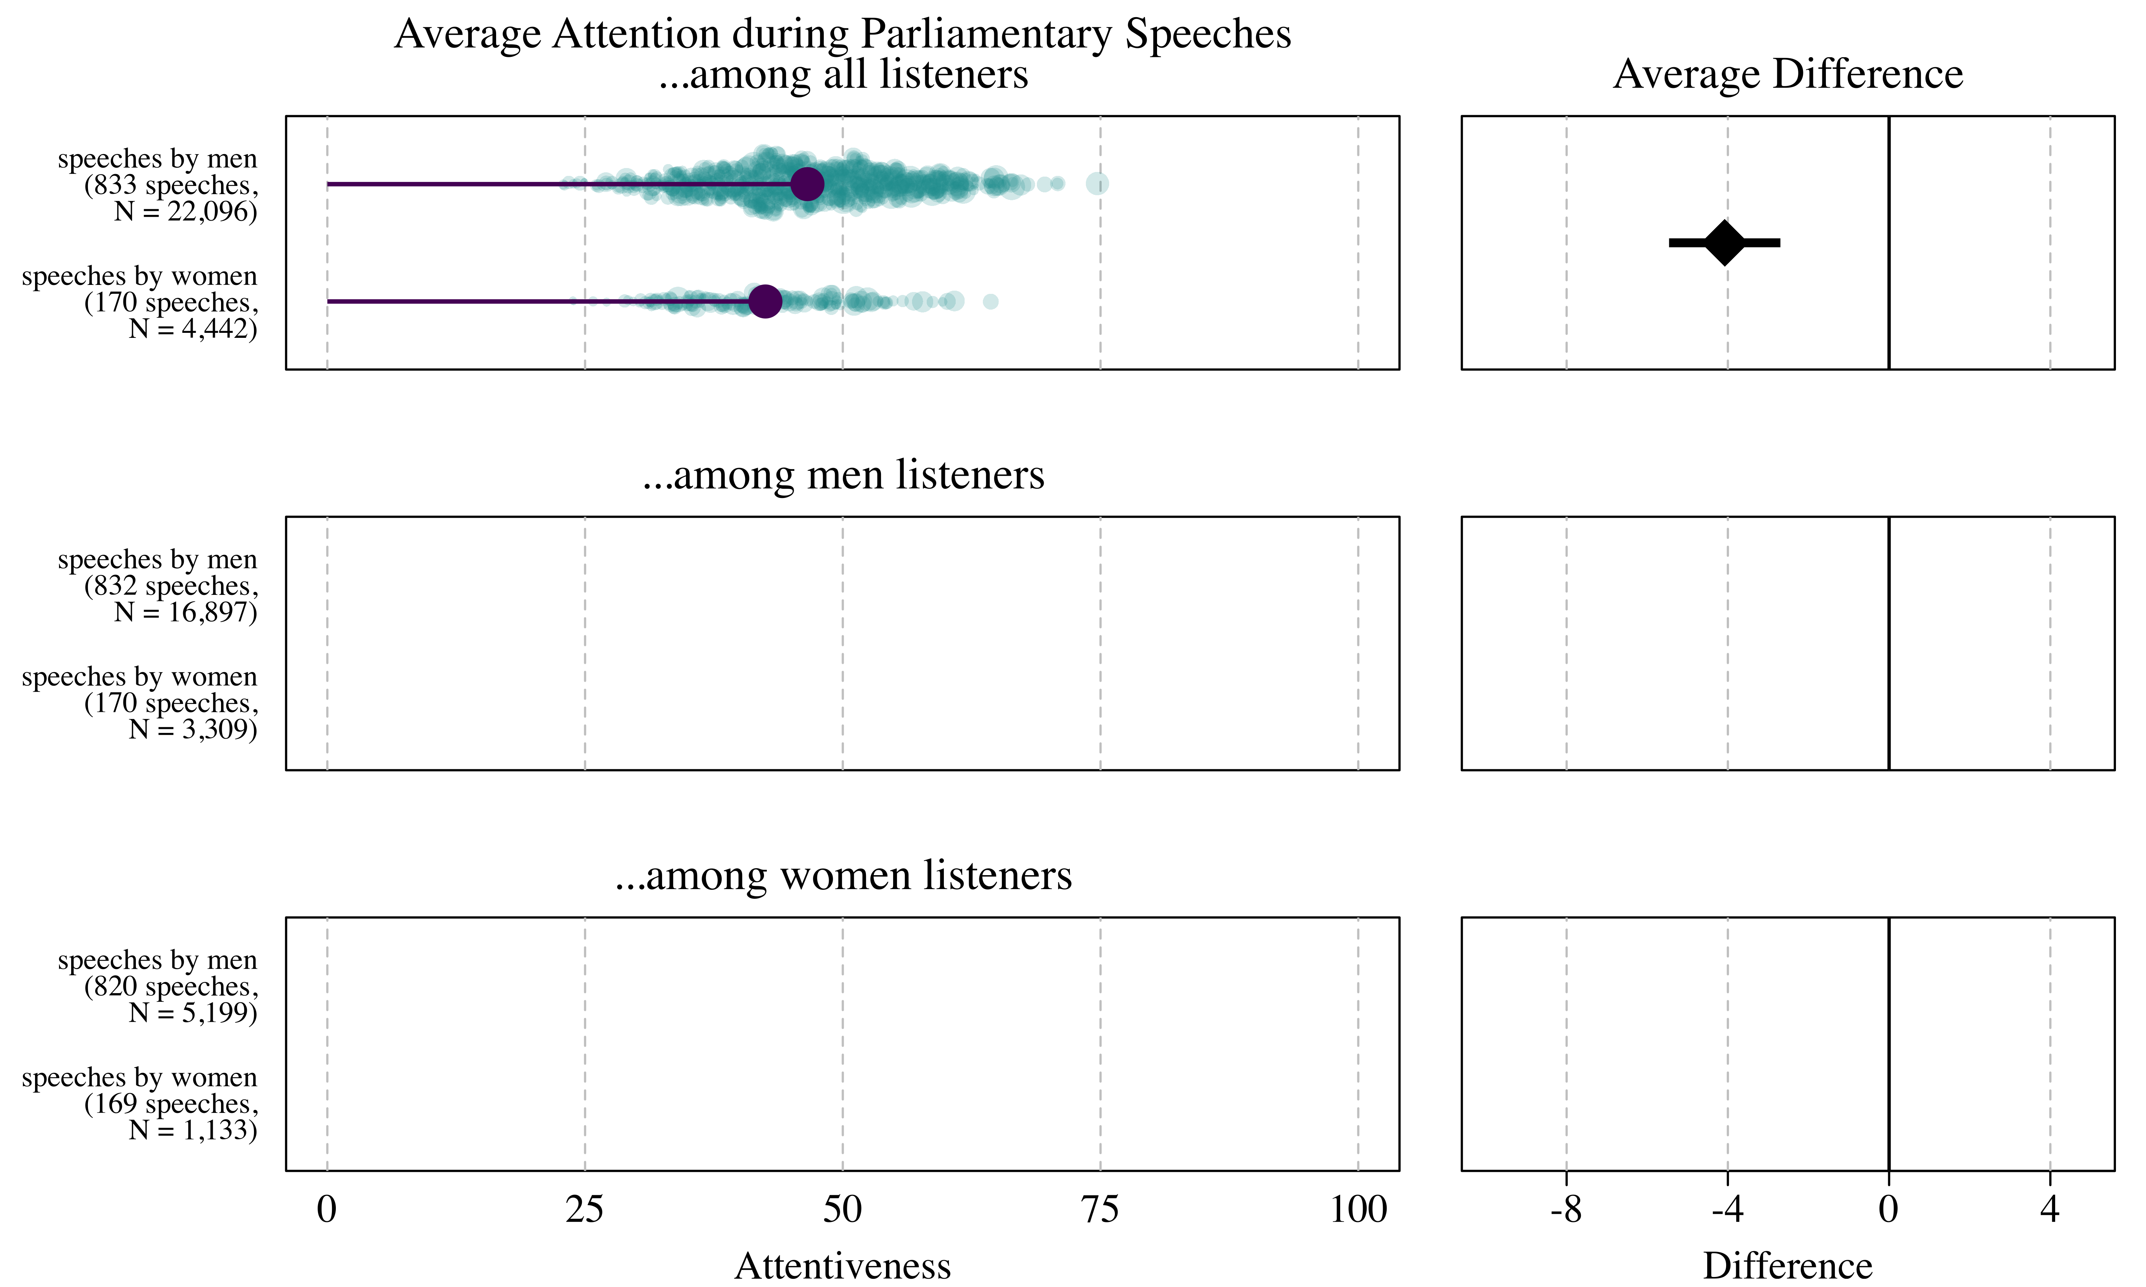
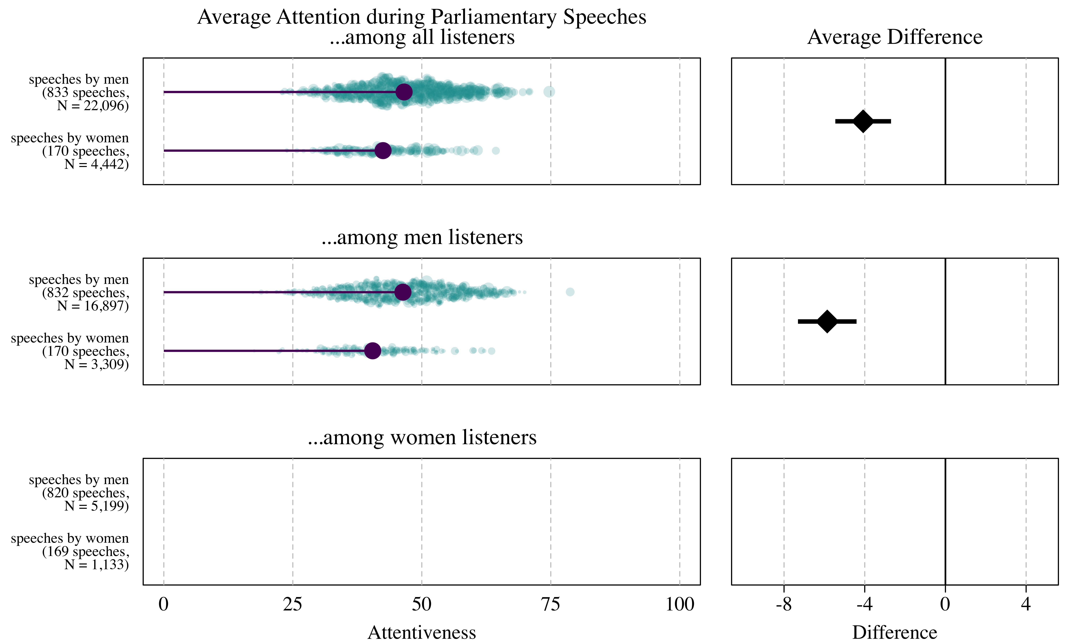
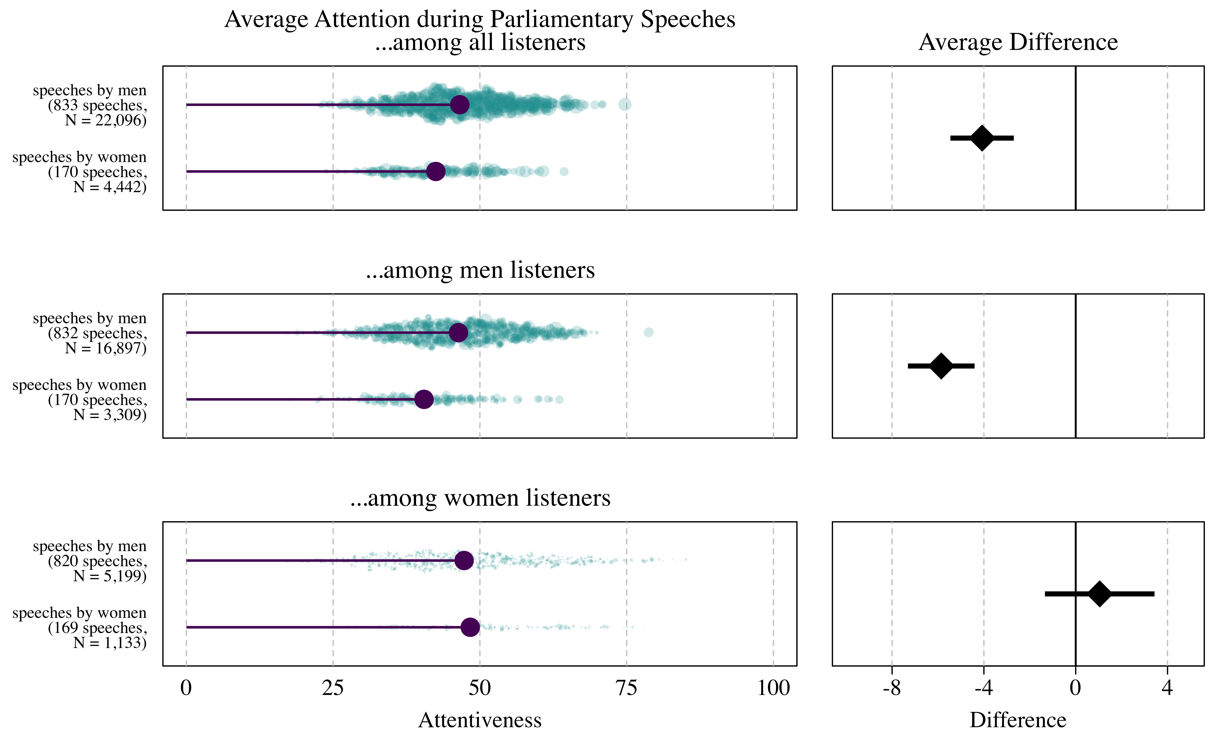
Average attention gap

Slide 27
Average attention gap
Main result:
  Women in the Landtag BW receive less attention than men, on average
  This difference is driven by men in the audience
  Women pay equal attention to both their men and women colleagues

Slide 28
Additional analyses
Open questions:
  Is the average attention gap a byproduct of other structural inequalities between men and women in parliament?

Slide 29
Byproduct of other structural inequalities?
Examples:
  Women speak later in the day, when attention is lower
  Women hold less prestigious positions and, thus, receive less attention
  ...

Slide 30
Byproduct of other structural inequalities?
Refined estimand:
  Average within-listener difference of attention,
  conditional on observable covariates
Estimation strategy:
  Linear regression models with legislator fixed effects (listener)
  Entropy balancing weights (Hainmueller, 2012)
Same party group Same government/opposition status Shared committee membership Same electoral district Neighboring electoral district Same Regierungsbezirk | Cabinet member (speaker) Committee chair (speaker) Topic expertise (speaker) Seniority (speaker) Front/mid/back-bencher (speaker) Topic expertise (listener) Party (listener) | Type of debate Morning vs. afternoon Length of prev. speeches in session #N speeches during debate Length of speech Voice pitch Detected frames per second

Slide 31
Byproduct of other structural inequalities?
Refined estimand:
  Average within-listener difference of attention,
  conditional on observable covariates
Estimation strategy:
  Linear regression models with legislator fixed effects (listener)
  Entropy balancing weights (Hainmueller, 2012)
Same party group Same government/opposition status Shared committee membership Same electoral district Neighboring electoral district Same Regierungsbezirk | Cabinet member (speaker) Committee chair (speaker) Topic expertise (speaker) Seniority (speaker) Front/mid/back-bencher (speaker) Topic expertise (listener) Party (listener) | Type of debate Morning vs. afternoon Length of prev. speeches in session #N speeches during debate Length of speech Voice pitch Detected frames per second

Slide 32
Byproduct of other structural inequalities?
Refined estimand:
  Average within-listener difference of attention,
  conditional on observable covariates
Estimation strategy:
  Linear regression models with legislator fixed effects (listener)
  Entropy balancing weights (Hainmueller, 2012)
Same party group Same government/opposition status Shared committee membership Same electoral district Neighboring electoral district Same Regierungsbezirk | Cabinet member (speaker) Committee chair (speaker) Topic expertise (speaker) Seniority (speaker) Front/mid/back-bencher (speaker) Topic expertise (listener) Party (listener) | Type of debate Morning vs. afternoon Length of prev. speeches in session #N speeches during debate Length of speech Voice pitch Detected frames per second

Slide 33
Byproduct of other structural inequalities?
Refined estimand:
  Average within-listener difference of attention,
  conditional on observable covariates
Estimation strategy:
  Linear regression models with legislator fixed effects (listener)
  Entropy balancing weights (Hainmueller, 2012)
Same party group Same government/opposition status Shared committee membership Same electoral district Neighboring electoral district Same Regierungsbezirk | Cabinet member (speaker) Committee chair (speaker) Topic expertise (speaker) Seniority (speaker) Front/mid/back-bencher (speaker) Topic expertise (listener) Party (listener) | Type of debate Morning vs. afternoon Length of prev. speeches in session #N speeches during debate Length of speech Voice pitch Detected frames per second

Slide 34
Byproduct of other structural inequalities?
Refined estimand:
  Average within-listener difference of attention,
  conditional on observable covariates
Estimation strategy:
  Linear regression models with legislator fixed effects (listener)
  Entropy balancing weights (Hainmueller, 2012)
Same party group Same government/opposition status Shared committee membership Same electoral district Neighboring electoral district Same Regierungsbezirk | Cabinet member (speaker) Committee chair (speaker) Topic expertise (speaker) Seniority (speaker) Front/mid/back-bencher (speaker) Topic expertise (listener) Party (listener) | Type of debate Morning vs. afternoon Length of prev. speeches in session #N speeches during debate Length of speech Voice pitch Detected frames per second

Slide 35
Byproduct of other structural inequalities?
Attention gap, all listener
Mean comparison: - 4.08 pp (0.71)
+ listener fixed effects: - 3.24 pp (0.68)
+ entropy balancing weights: - 3.45 pp (0.77)
+ exclude party leader speeches: - 2.94 pp (0.79)
Attention gap, only men listener
Mean comparison: - 5.86 pp (0.74)
+ listener fixed effects: - 5.01 pp (0.68)
+ entropy balancing weights: - 4.65 pp (0.76)
+ exclude party leader speeches: - 4.29 pp (0.77)
[details⎘]

Slide 36
Additional analyses
Open questions:
  Is the average attention gap a byproduct of other structural inequalities between men and women in parliament?
    Observable contextual factors explain the attention gap only partially
  Is the size of the gender attention gap substantively meaningful?

Slide 37
Is the attention gap substantively meaningful?
Difficult to specify a threshold above which the attention gap is “important”
Ideally: Study of the downstream consequences of the attention gap
  But: Limited time frame makes this difficult
To still make progress:
Benchmarking against other attention disparities
  Is the attention gap rather a product of explicit hostility or implicit bias?

Slide 38
Is the attention gap substantively meaningful?
[details⎘]

Slide 39
Additional analyses
Open questions:
  Is the average attention gap a byproduct of other structural inequalities between men and women in parliament?
    Observable contextual factors explain the attention gap only partially
  Is the size of the gender attention gap substantively meaningful?
    No definite answer
    Partisanship is more important for attention than gender
    Implicit biases is a more plausible explanation than explicit hostility

Slide 40
Additional analyses
Is the attention gap driven by dyadic dependencies?
  Network analysis model: No [details ⎘]
Is the average attention gap driven by only a few listeners?
  Multilevel random-effects model: There is individual-level variation, but gap is not driven by a few outliers [details ⎘]
Is the attention gap driven by data-preprocessing choices?
  Specification curve analysis: No [details ⎘]
Does the attention gap vary conditional on the debated topic?
  Text analysis to measure stereotypically feminine/masculine issues:
  No robust evidence after accounting for partisanship [details ⎘]

Slide 41
Conclusion:
Summary and contributions

Slide 42
Summary and contributions
RQ: Do legislators pay less attention to their women colleagues during parliamentary meetings?
Methodological contribution: Computer vision in political science
Computer vision techniques to analyse video footage capturing legislators while attending parliamentary meetings
[previous research using computer vision for video analysis in political science ⎘]
Substantive contribution:
First non-anecdotal evidence on the gender attention gap
  Women receive less attention than men in the Landtag BW
  This difference is driven by men who listen less to women
  Women pay equal attention to men and women

Slide 43

Thank you!
Oliver Rittmann
oliver.rittmann@uni-mannheim.de
Rittmann, Oliver, Dominic Nyhuis, and Tobias Ringwald. Forthcoming. “Gendered Patterns of Parliamentary Attention.”
Online first: The Journal of Politics.

Slide 44
Appendix
Face recognition validation ⎘
Attention classification ⎘
Calculation of the dependent variable ⎘
Fixed-effects models ⎘
Network model analysis ⎘
Benchmarking the attention gap ⎘
Specification curve analysis ⎘
Individual-level attention gap ⎘
Measuring issue congruity ⎘
Interaction models ⎘
Computer vision in political science ⎘
Ongoing work and broader research agenda ⎘
References ⎘

Slide 45
Appendix: Face recognition
Validation
Test set: 30 randomly sampled images per legislator
Classification accuracy: 99.7%
[back to presentation]
[back to appendix]

Slide 46
Appendix: Attention classification
Codebook instructions
  Attentive
    The legislator looks forward (orthogonal to shoulder axis)
    If eyes closed: attentive only if the chin is raised (blinking)
  Not attentive
    The legislator does not look forward (looks down, to the left/right, or backwards)
    If eyes closed: not attentive if lowered or supported head
  Unclear
46,000 labeled images
  90% train set, 10% test set
  500 images labeled by all four coders to monitor inter-coder reliability

Slide 47
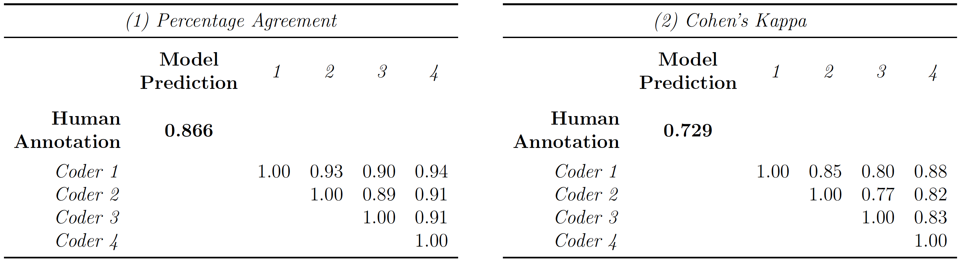
Appendix: Attention classification
[back to presentation]
[back to appendix]

Slide 48
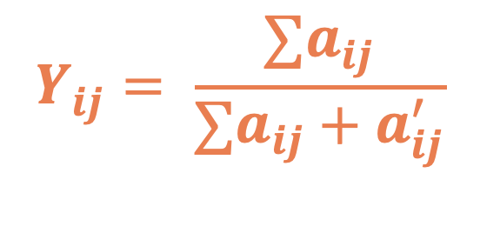
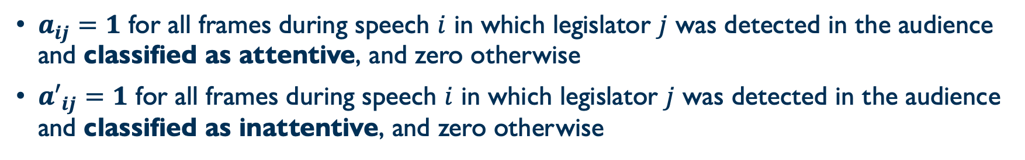
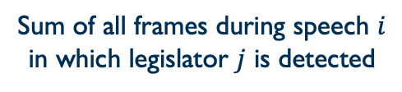
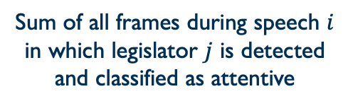
Appendix: Dependent variable
Sum of all frames during speech $i$
in which legislator $j$ is detected
and classified as attentive
$$Y_{ij}= \frac{∑a_{ij}}{∑a_{ij}+a_{ij}^{′}}$$
Sum of all frames during speech $i$
in which legislator $j$ is detected
$a_{ij}=1$ for all frames during speech $i$ in which legislator $j$ was detected in the audience and classified as attentive, and zero otherwise
${a′}_{ij}=1$ for all frames during speech $i$ in which legislator $j$ was detected in the audience and classified as inattentive, and zero otherwise
[back to presentation]
[back to appendix]

Slide 49
Appendix: Within-listener comparison
Concerns about simple mean comparison:
  Camera does usually not capture the full audience
  Women in the audience are concentrated in few party groups
  The result may be confounded by selection mechanism
Does the attention gap persist when tracing legislators over time?
  Legislator fixed-effect models

Slide 50
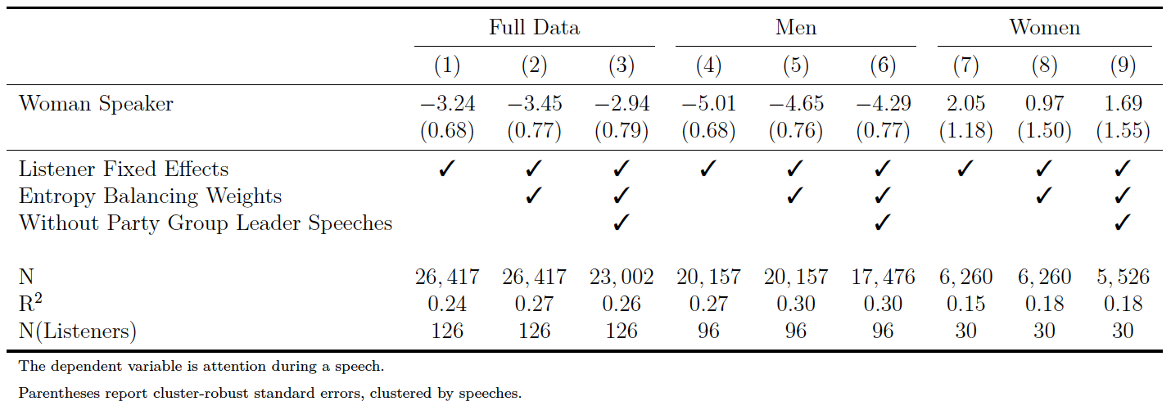
Appendix: Within-listener comparison
[back to appendix]

Slide 51
Appendix: Network model analysis
Dyadic dependencies may violate the conditional independence assumption underlying conventional regression models
Types of (potential) dyadic dependencies:
  Listener heterogeneity (some listeners generally are more attentive than others)
  Speaker heterogeneity (some speakers receive generally more attention than others)
  Speaker-listener covariance (those who are more attentive also receive more attention)
  Reciprocity (pairs of legislators who are reciprocally attentive to one another)
Network analysis to model such dependencies

Slide 52
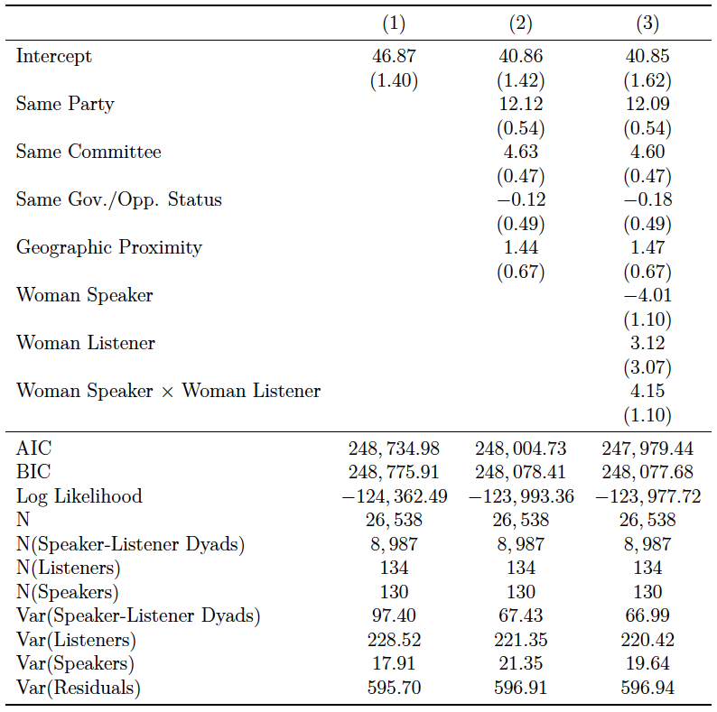
Appendix: Network model analysis

Slide 53
Appendix: Network model analysis

Slide 54
Appendix: Network model analysis
[back to presentation]
[back to appendix]

Slide 55
Appendix: Entropy balancing
[back to presentation]
[back to appendix]

Slide 56
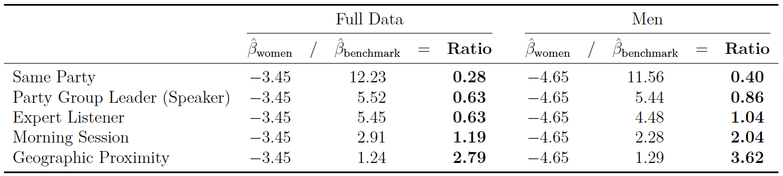
Appendix: Benchmarking the attention gap
[back to presentation]
[back to appendix]

Slide 57
Appendix: Specification curve analysis
A series of preprocessing decisions precede the analysis
  Minimum and maximum length of a speech to be included in the analysis
  Minimum share of frames in which a legislator must be detected during one speech
  How often a legislator must be observed in both conditions (listening to women and men)
  Whether to refine entropy balancing weights or not
We do not want our results to depend on these decisions
Specification curve analysis (Simonsohn et al., 2020)
  360 analyses based on varying preprocessing decisions

Slide 58
Appendix: Specification curve analysis
[back to presentation]
[back to appendix]

Slide 59
Appendix: Attention gap driven by few listener?
The average attention gap may be driven by a few high-discrimination legislators, whereas the majority shows no discrimination
Estimation of individual-level attention gap:
Multilevel model
Random-effects:
Intercepts and slopes vary by listener
[back to presentation]
[back to appendix]

Slide 60
Appendix: Topic moderation?
Role congruity theory suggests that gender bias depends on issue context (Eagly & Karau, 2002)
  Issues incongruent with feminine stereotypes → less attention
  Issues congruent with feminine stereotypes → more attention
Computational text analysis to measure the substantive incongruity of a speech with stereotypically feminine issues

Slide 61
Appendix: Measurement of issue incongruity
Goal:
Measure the congruity of a speech with stereotypically feminine and masculine issues
Measurement approach:
Combine word-embeddings and dictionaries to scale the text of speeches between two semantic poles (Gennaro & Ash, 2022)

Slide 62
Appendix: Measurement of issue incongruity
Components of the measure
Dictionary to represent stereotypically masculine issue areas
  [military, weapons delivery, armed,
  forces, trade, export, import, taxes,
  economy, economic growth,
  security, police]*
*translated from German
Dictionary to represent stereotypically feminine issue areas
  [education, family, pregnancy, care,
  poverty, wage inequality, health,
  support, social work, children,
  parenting]*

Slide 63
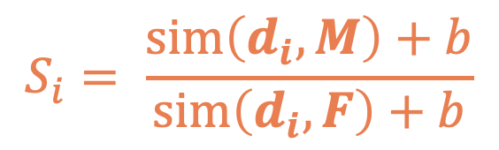
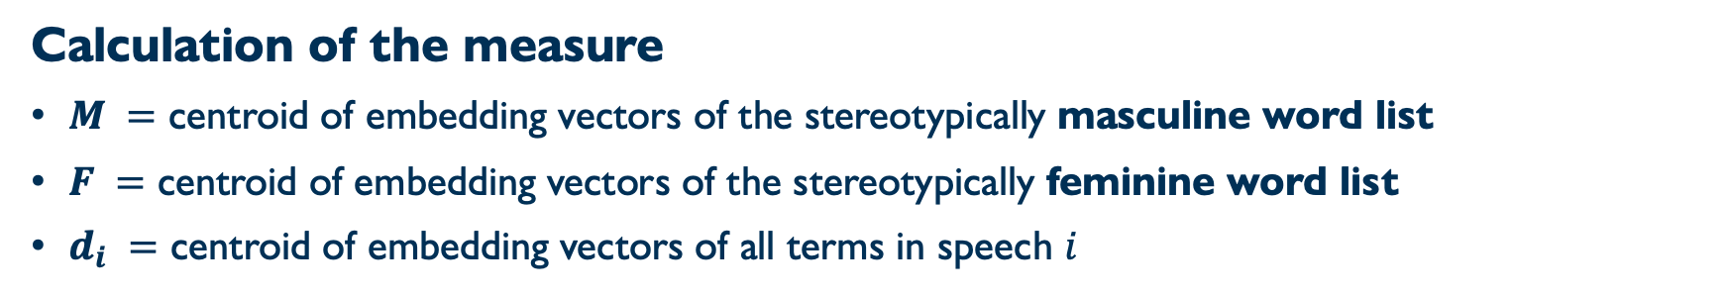
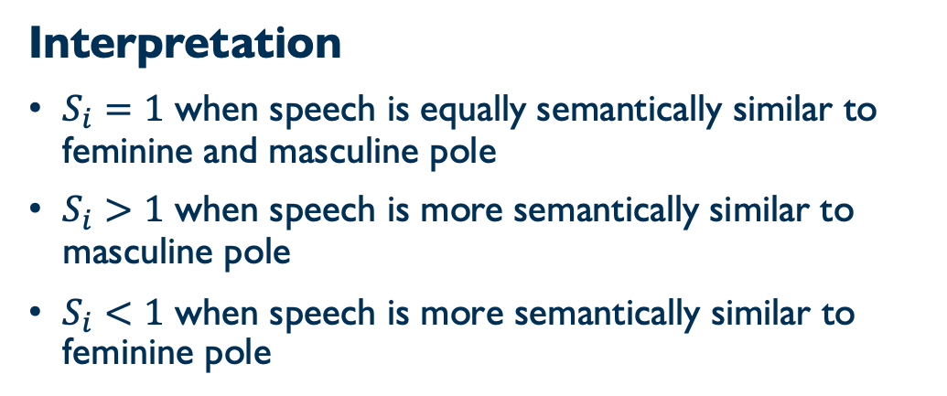
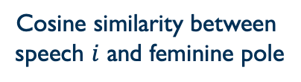
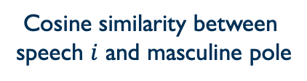
Appendix: Measurement of issue incongruity
Calculation of the measure
$M =$ centroid of embedding vectors of the stereotypically masculine word list
$F =$ centroid of embedding vectors of the stereotypically feminine word list
$d_{i} =$ centroid of embedding vectors of all terms in speech $i$
Cosine similarity between
speech $i$ and masculine pole
Interpretation
$S_{i}=1$ when speech is equally semantically similar to feminine and masculine pole
$S_{i}>1$ when speech is more semantically similar to masculine pole
$S_{i}<\text{1}$ $\text{when} \text{speech} \text{is} \text{more} \text{semantically} \text{similar} \text{to} \text{feminine} \text{pole}$
$$S_{i}= \frac{sim\left(d_{i}, M\right)+b}{sim\left(d_{i}, F\right)+b}$$
Cosine similarity between
speech $i$ and feminine pole
[back to presentation]
[back to appendix]

Slide 64
Appendix: Interaction models, detailed

Slide 65
Appendix: Interaction models, detailed
With control for shared party affiliation
[back to presentation]
[back to appendix]

Slide 66
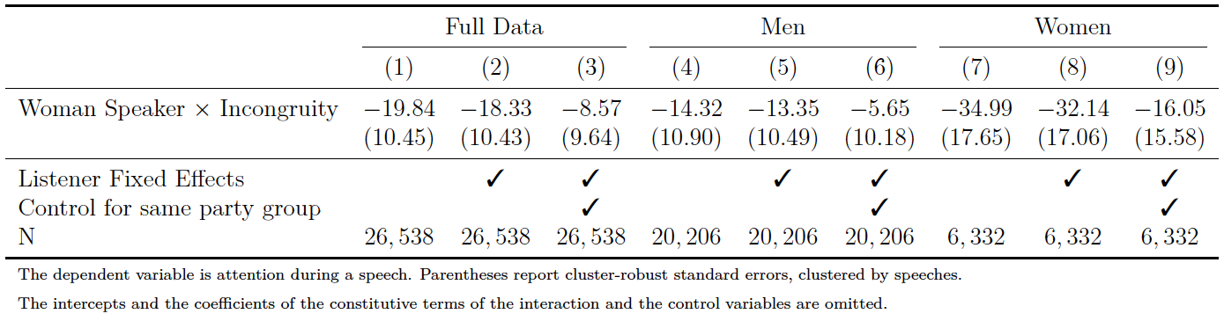
Appendix: Interaction models
[back to presentation]
[back to appendix]

Slide 67
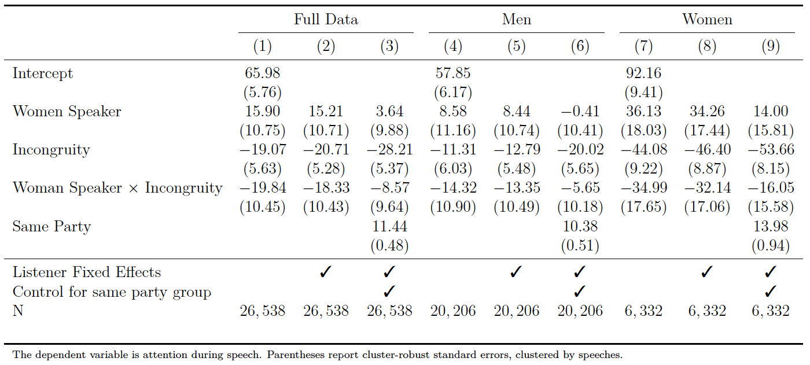
Appendix: Interaction models, detailed
[back to presentation]
[back to appendix]

Slide 68
Appendix: Computer vision in political science
Televised presidential debates
  US Presidential elections: Boussalis et al. (2021, APSR)
  German Federal elections: Boussalis & Coan (2020, PolCom)
Campaign ads: Tarr et al. (2022, PA), Neumann et al. (2022, CCR)
Parliamentary debates
  US House of Representatives:
  Rittmann et al. (2025, BJPolS), Dietrich (2021, PA)
Traffic cameras to study political behaviour
  Racial avoidance on city streets:
  Dietrich & Sands (2024, Nature Human Behaviour)
  Turnout: Dietrich et al. (2024, R&P)
[back to presentation]
[back to appendix]

Slide 69
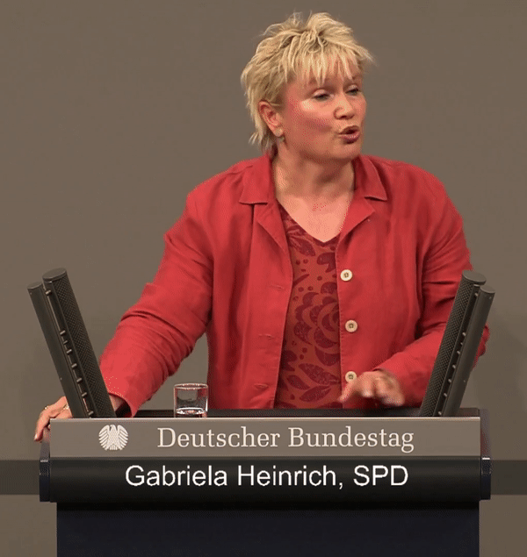
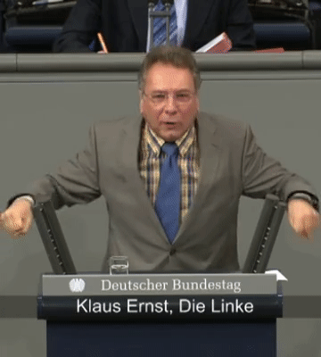
Ongoing work and broader research agenda

Slide 70
Ongoing work and broader research agenda
Published research
Oliver Rittmann. 2024.
“Legislators’ Emotional Engagement with Women’s Issues: Gendered Patterns of Vocal Pitch in the German Bundestag.”
British Journal of Political Science.
Oliver Rittmann, Tobias Ringwald, and Dominic Nyhuis. 2025.
“Public Opinion and Emphatic Legislative Speech: Evidence from an Automated Video Analysis.”
British Journal of Political Science.
Oliver Rittmann, Dominic Nyhuis, and Tobias Ringwald. 2025.
“Gendered Patterns of Parliamentary Attention.”
The Journal of Politics.
Working papers
Oliver Rittmann. 2025.
“A Measurement Framework for Computationally Analyzing Politicians’ Body Language.”
OSF Working Paper.
[back to presentation]
[back to appendix]

Slide 71
References
Anzia, Sarah F., and Christopher R. Berry. 2011. "The Jackie (and Jill) Robinson Effect: Why Do Congresswomen Outperform Congressmen?" American Journal of Political Science 55(3): 478-493.
Bernhard, Rachel and Justin de Benedictis-Kessner. 2021. “Men and Women Candidates Are Similarly Persistent After Losing Elections.” Proceedings of the National Academy of Sciences of the United States of America 118(26): e2026726118.
Clayton, Amanda, Amanda Lea Robinson, Martha C. Johnson, and Ragnhild Muriaas. 2020. "(How) do voters discriminate against women candidates? Experimental and qualitative evidence from Malawi." Comparative Political Studies 53(3-4): 601-630.
Deng, Jia, Wei Dong, Richard Socher, Li-Jia Li, Kai Li and Li Fei-Fei. 2009. ImageNet: A Large-Scale Hierarchical Image Database. In 2009 IEEE Conference on Computer Vision and Pattern Recognition. pp. 248–255.
Dietrich, Bryce J., Matthew Hayes and Diana Z. O’Brien. 2019. “Pitch Perfect: Vocal Pitch and the Emotional Intensity of Congressional Speech.” American Political Science Review 113(4):941–962.
Eagly, Alice H. and Steven J. Karau. 2002. “Role Congruity Theory of Prejudice Toward Female Leaders.” Psychological Review 109(3):573–598.
Erikson and Josefsson. 2019. “The Legislature as a Gendered Workplace: Exploring Members of Parliament’s Experiences of Working in the Swedish Parliament.” International Political Science Review 40(2): 197-214.
Fox, Richard L. and Jennifer L. Lawless. 2005. "To Run or Not to Run for Office: Explaining Nascent Political Ambition." American Journal of Political Science, 49(3), 642-659.
Gennaro, Gloria and Elliott Ash. 2022. “Emotion and Reason in Political Language.” The Economic Journal 132(643):1037–1059.
Hainmueller, Jens. 2012. “Entropy Balancing for Causal Effects: A Multivariate Reweighting Method to Produce Balanced Samples in Observational Studies.” Political Analysis 20(1):25–46.
He, Kaiming, Xiangyu Zhang, Shaoqing Ren and Jian Sun. 2016. Deep Residual Learning for Image Recognition. In Proceedings of the IEEE Conference on Computer Vision and Pattern Recognition. pp. 770–778.
Hu, Peiyun and Deva Ramanan. 2017. Finding Tiny Faces. In Proceedings of the IEEE Conference on Computer Vision and Pattern Recognition. pp. 951–959.
Kerevel, Yann P. and Lonna Rae Atkeson. 2013. “Explaining the Marginalization of Women in Legislative Institutions.” The Journal of Politics 75(4):980–992.
Krook, Mona Lena. 2018. “Westminster Too: On Sexual Harassment in British Politics.” Political Quarterly 89(1):65–72.
Simonsohn, Uri, Joseph P. Simmons and Leif D. Nelson. 2020. “Specification Curve Analysis.” Nature Human Behaviour 4(11):1208–1214.
Tensorflow. 2023. “TensorFlow Hub: MoveNet SinglePose Thunder.”
[back to appendix]

